Slide 2
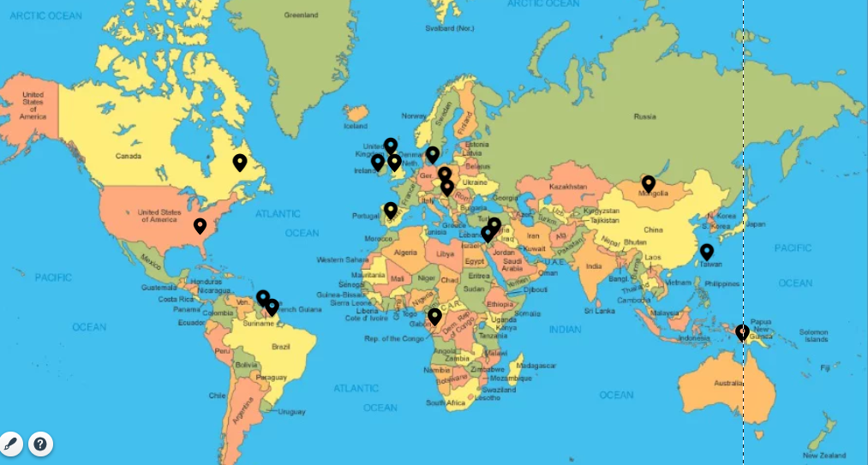
This is LIFE

Slide 3
Rehovot - Israel

Slide 5
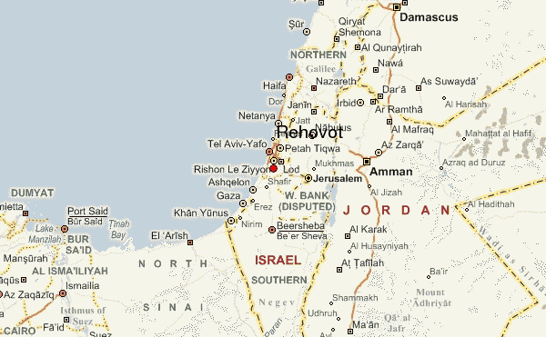
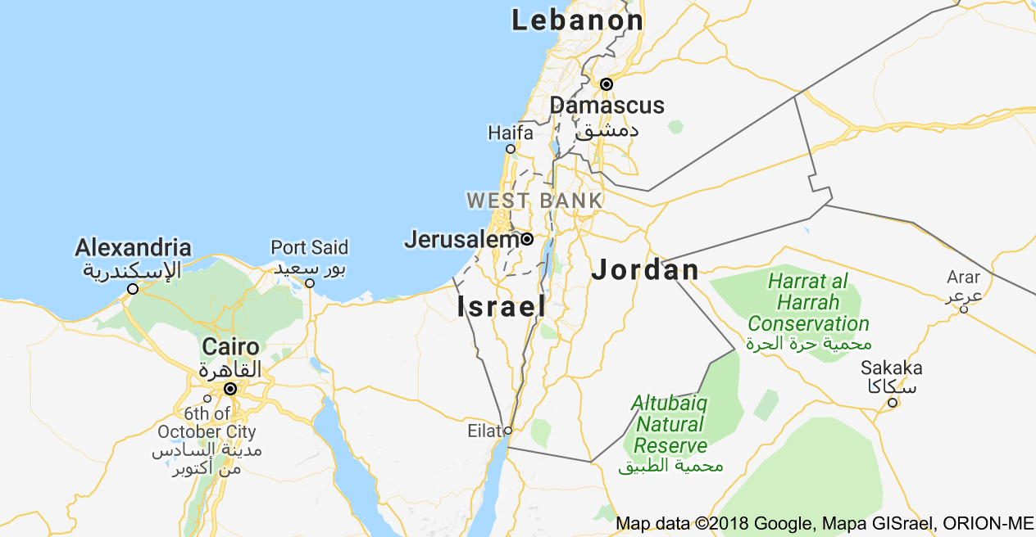

Slide 6
REHOVOT
Genesis 26:22: "And he called the name of it Rehoboth; and he said: 'For now the Lord hath made room for us, and we shall be fruitful in the land'."

Slide 7
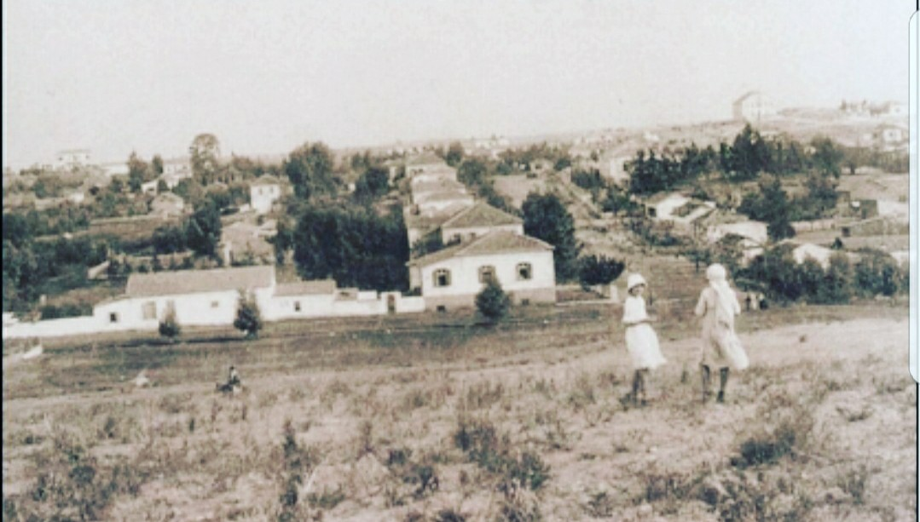
1898

Slide 8
2018

Slide 9
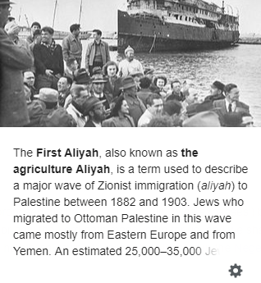
Founded in 1890 by Polish Jewish pioneers of the First Aliyah
land purchased from a Christian Arab by the Menuha Venahala society, an organization in Warsaw that raised funds for Jewish settlement in Eretz Israel.[

Slide 10
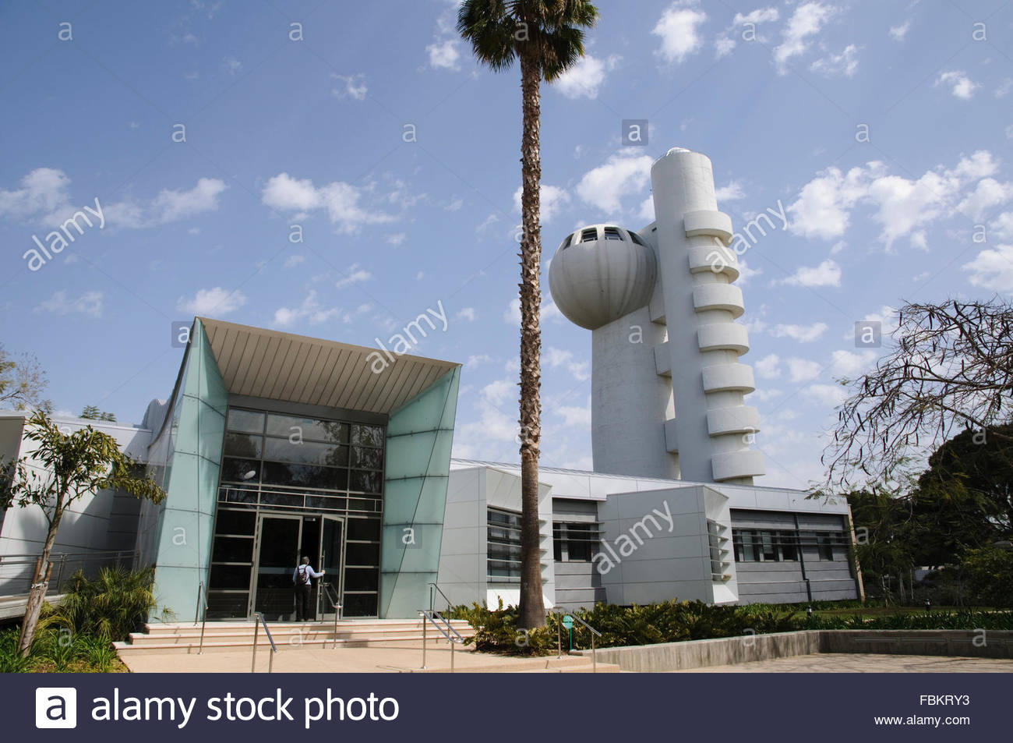
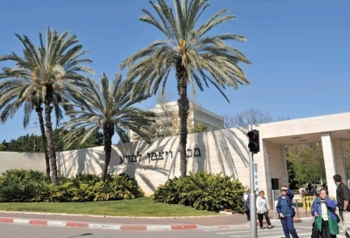
1914 - 965 1971 - 39,300
1948 - 12,500 2011 - 125,000
Majority East European and Native born Sabras with one of the largest Jewish ethnic minorities: Russian Jews, Yemenite Jews, and Ethiopian Jews,

Slide 12
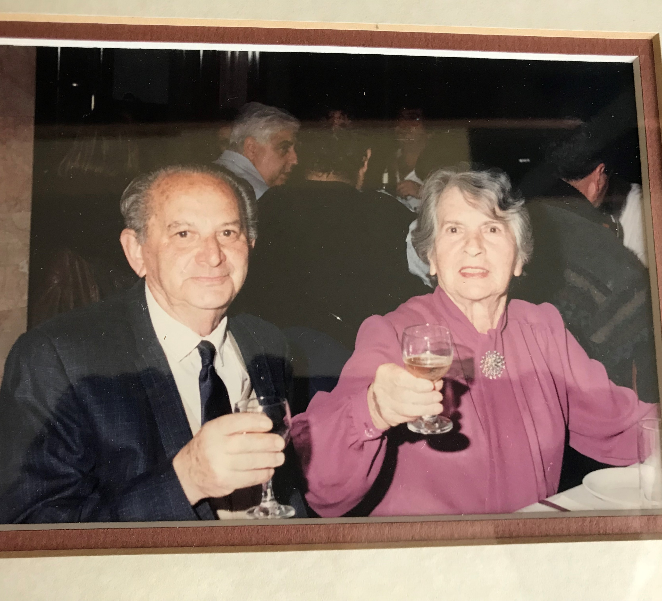
My Parents
Polish Jews
My Father was 17 in 1932
My Mother was 26 in 1935
Father family followed in 1938
Mother family perished in Holocaust
Only 3 sisters of 11 made it to Israel
My father was a Tile Layer
My Mother a Seamstress
Married in 1935
2 Siblings in Israel
My younger father died at 80
My older mother died at 94

Slide 13
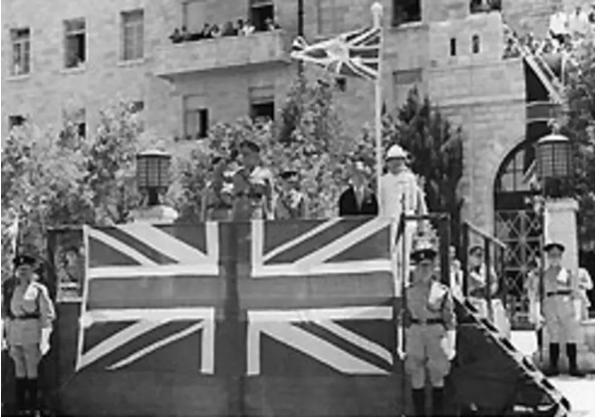
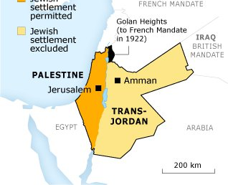
The British Mandate
The mandate formalized British rule in the southern part of Ottoman Syria from 1923–1948. Each of the principal Allied powers had a hand in drafting the proposed mandate—although some, including the United States, had not declared war on the Ottoman Empire and did not become members of the League of Nations.

Slide 14
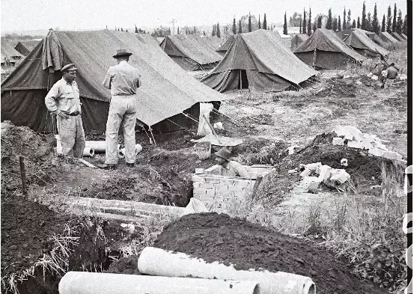
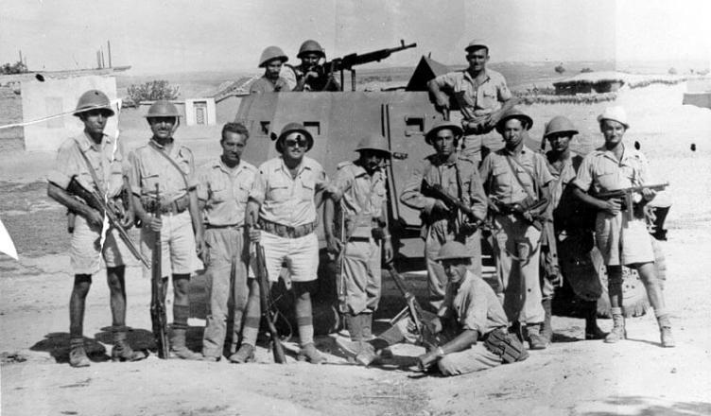
1948 - 1956

Slide 15
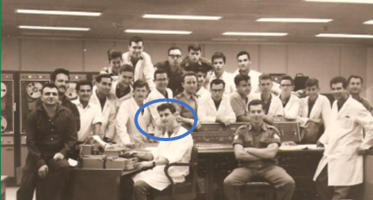
Not a Warrior

Slide 16
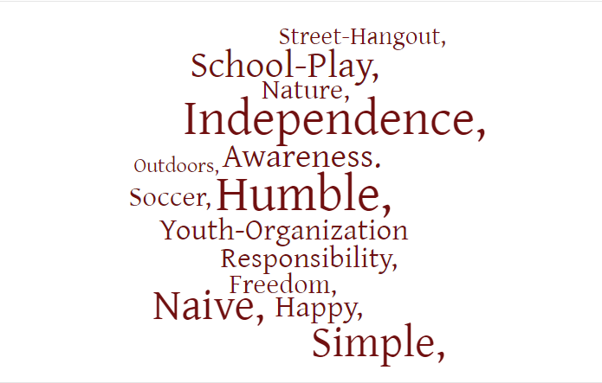
Childhood Life in Rehovot

Slide 17
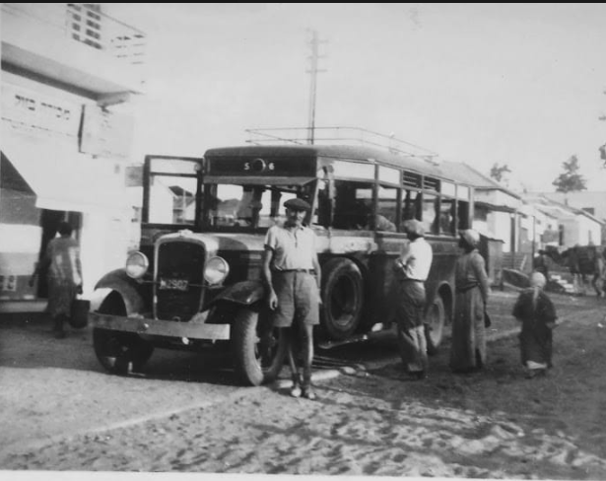
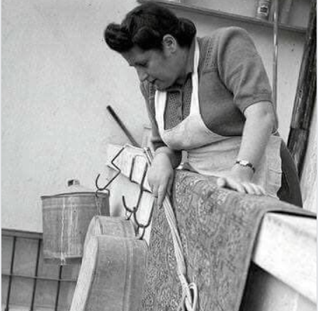
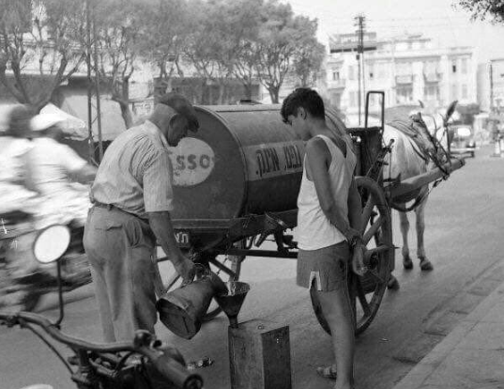
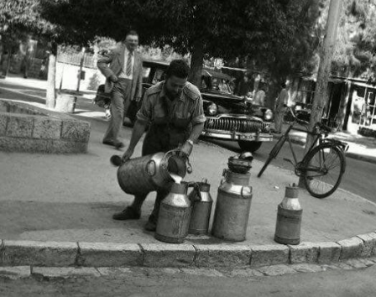
A Simple Life Indeed

Slide 18
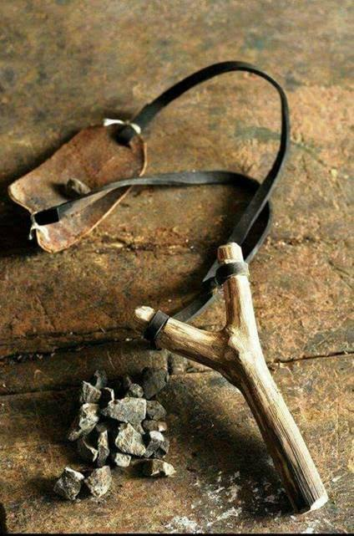
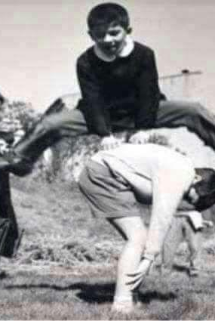
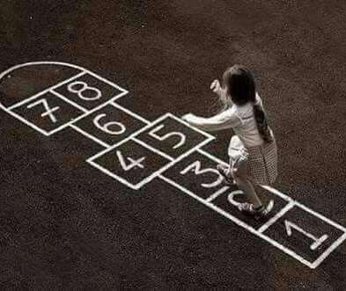
Social Innovation

Slide 19
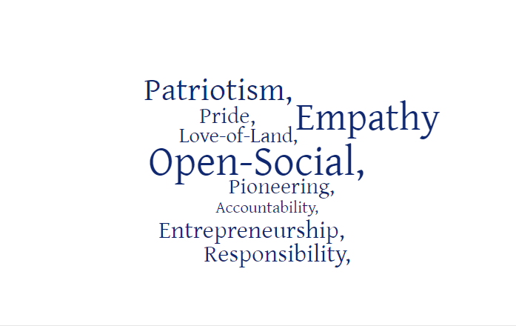
Core Values – Nature or Nurture?

Slide 20
Safety Net Democracy Common Cause

Slide 22
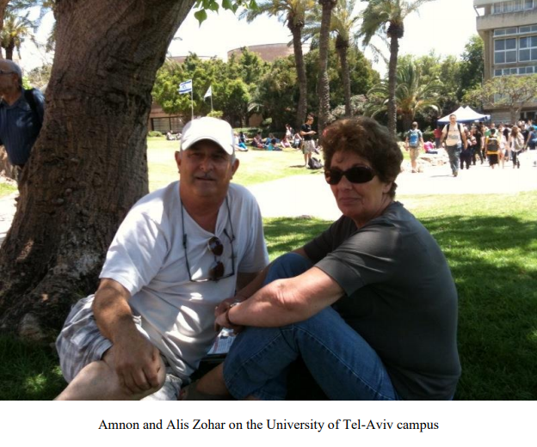
Coming Home after 40 Years

Slide 23
10 Best

Slide 24
10 Worst

Slide 26
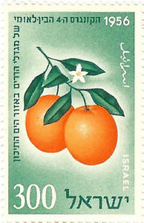
A small museum in Rehovot offers a look at the history of what once was a major industry in Israel – the growing and exporting of citrus fruit. Tucked away on the outskirts of Rehovot, close to the Weizmann Institute of Science, is a museum that presents the history of the country's citrus industry.

Slide 29
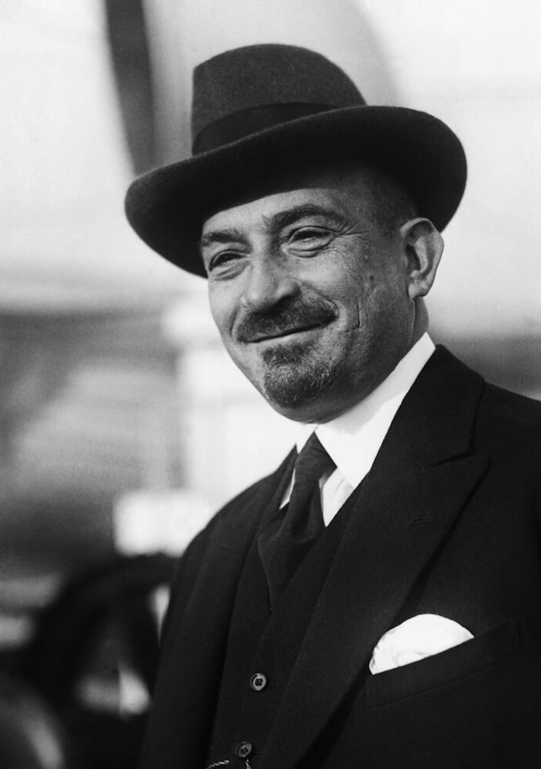
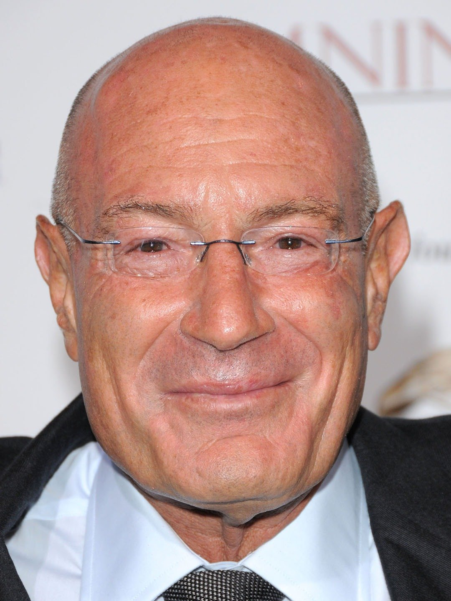
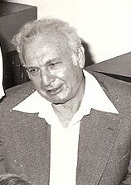
Chaim Weizman –First President of Israel Ada Yonath - 2009, received the Nobel Prize in Chemistry Arnon Milchan – Hollywood Mogul - 12 Years a Slave, JFK, Heat, Fight Club, Mr. and Mrs. Smith,
Efraim Katzir - Israeli biophysicist and Israeli Labor Party politician. He was the fourth President of Israel from 1973 until 1978.

Slide 31
Thank You!

