Slide 1
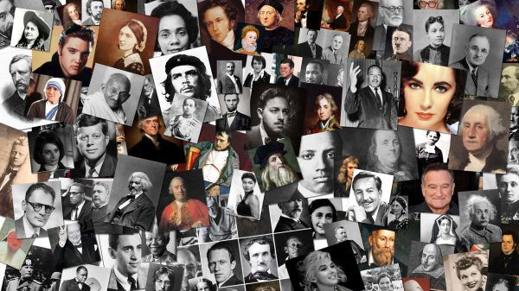
Leaders & Heroes
People who made a difference
Lecture # 2 – Heads of States

Slide 2
World Leaders ? National Heroes

Slide 3
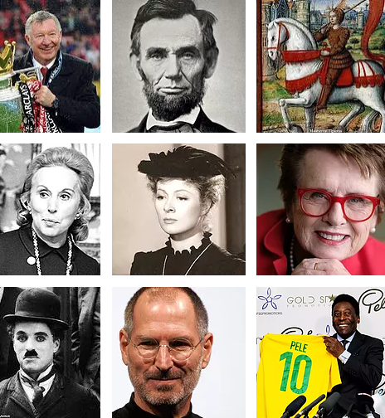
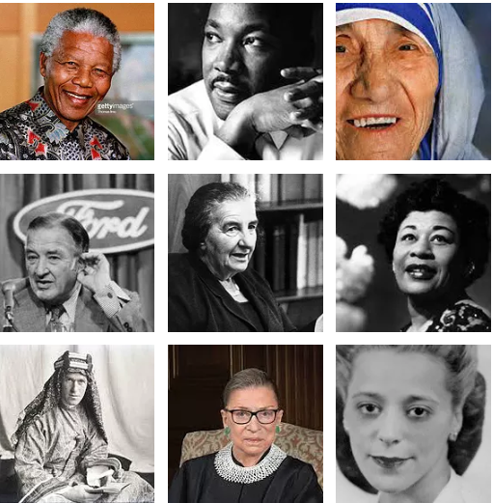
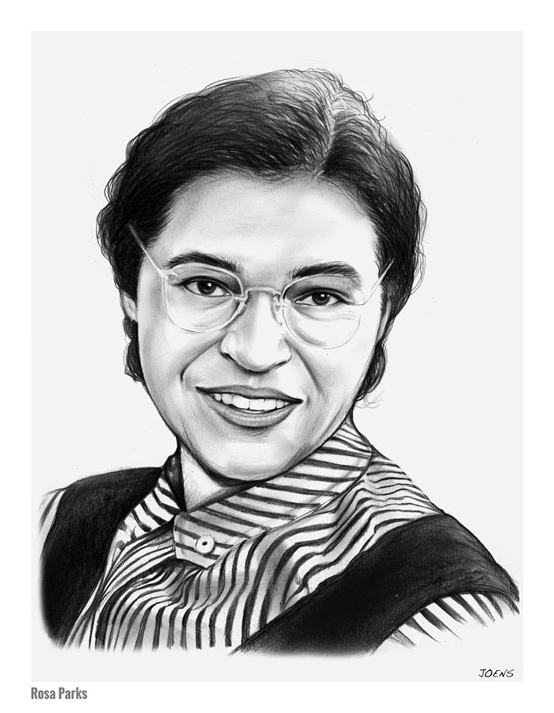

Slide 4
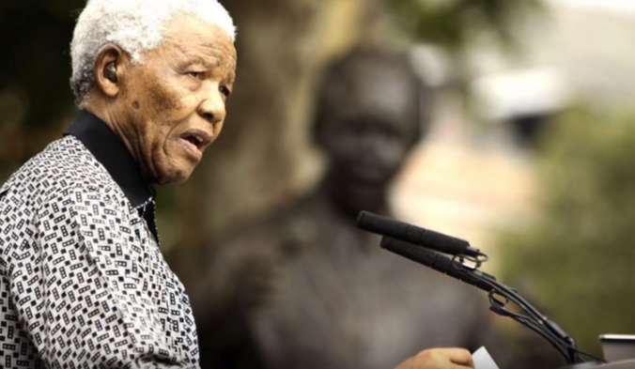
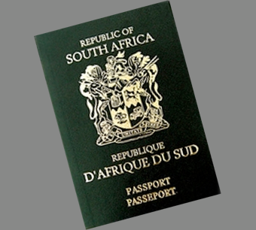
Ended Apartheid

Slide 6
https://www.youtube.com/watch?v=jgQBoXsxr8w

Slide 7
Leadership Lessons from Nelson Mandela
1. Have a vision that is for the greater good
Mandela envisioned a South Africa without apartheid, where every man would be free and equal in the eyes of the nation. It was this vision that sustained him through his darkest days in prison.
2. You need to fight for your vision
Mandela spent 27 years in prison before he was elected President of South Africa. Even faced with such a huge setback, he never gave up on his vision.
3. Leadership is not tied to a position
Mandela is a great example of how leadership is not tied to a position. Winning the South African presidency formalized his position as a leader and enlarged the scope of his influence and impact. However, Mandela held a considerable amount of influence even before his presidency, and continued to use his political and social capital after he retired.

Slide 8
https://www.youtube.com/watch?v=NOr4F2eNDq8

Slide 9
https://www.youtube.com/watch?v=LSwHDNCLJhU

Slide 10
Nelson Mandela’s Words Of Wisdom
https://www.youtube.com/watch?v=lCAfoFPvTJU

Slide 12
ABOLISHED SLAVERY
https://www.youtube.com/watch?v=L80_q2tPveo

Slide 13
https://www.youtube.com/watch?v=i-g7Q-UkHPo

Slide 14
https://www.youtube.com/watch?v=DUkzizwLhXw

Slide 15
https://www.youtube.com/watch?v=1qjtugr2618

Slide 16
https://www.youtube.com/watch?v=6n-ltuLEadM

Slide 17
https://youtu.be/50wU8AsViDM

Slide 18
http://theprimeministers.org/biography-golda-mier/

Slide 19
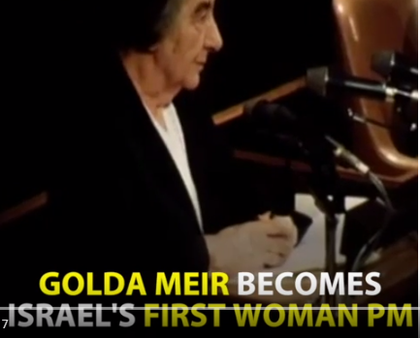
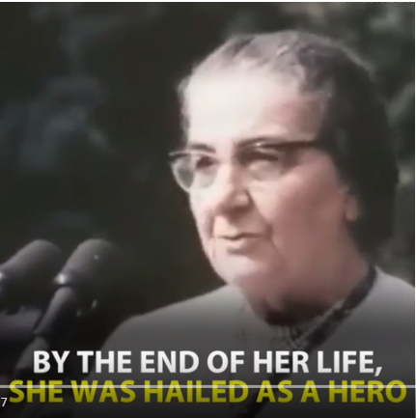
https://www.youtube.com/watch?v=TWCW8bhJANo

Slide 20
https://www.youtube.com/watch?v=optCXqUad1E
Golda Meir – During the 1973 Yom Kippur War

Slide 21
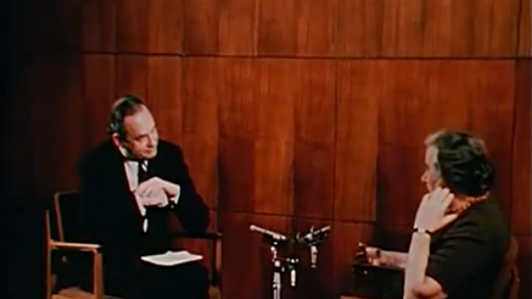
Golda Meir on Palestinian State
https://www.youtube.com/watch?v=xt2YKL0ub64

Slide 22
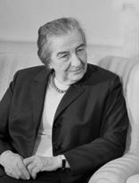
Golda Meir > Quotes
“We can forgive the Arabs for killing our children. We cannot forgive them for forcing us to kill their children. We will only have peace with the Arabs when they love their children more than they hate us.”
“Not being beautiful was the true blessing. Not being beautiful forced me to develop my inner resources. The pretty girl has a handicap to overcome. ”
“Old age is like a plane flying through a storm. Once you're aboard there's nothing you can do.” “There's no difference between one's killing and making decisions that will send others to kill. It's exactly the same thing, or even worse.”
“Ben-Gurion described me as 'the only man' in his cabinet. What amused me about is that he thought that this was the greatest compliment that could be paid to a woman. I very much doubt that any man would have been flattered if I had said about him that he was the only woman in the government!”

Slide 23
https://www.youtube.com/watch?v=jZXVVy7k3xo

