Slide 1
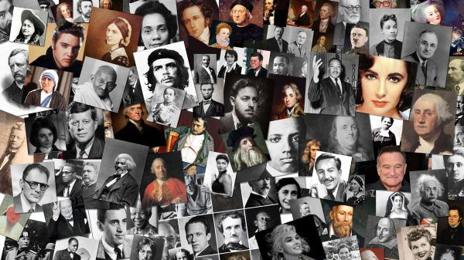
Leaders & Heroes
People who made a difference
Lesson #8 – Canadian Leaders & Heroes

Slide 4
Where it all started

Slide 5
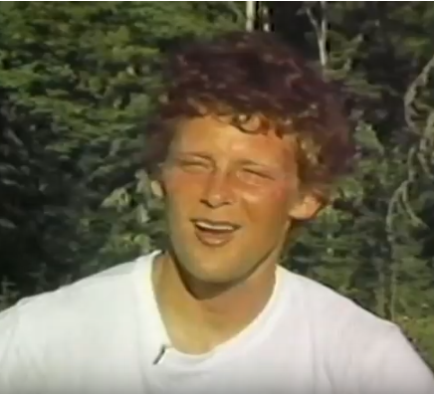
Terry Fox In His Own Words

Slide 12
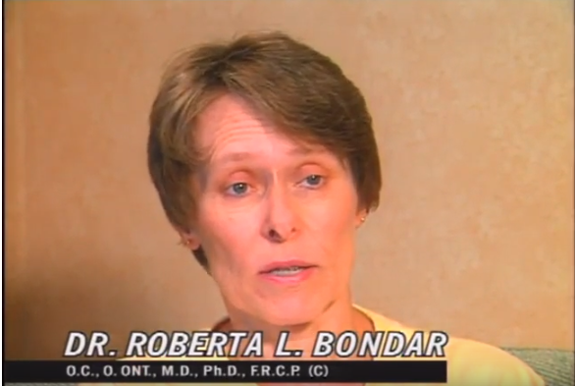
Why Be An Astronaut?

Slide 13
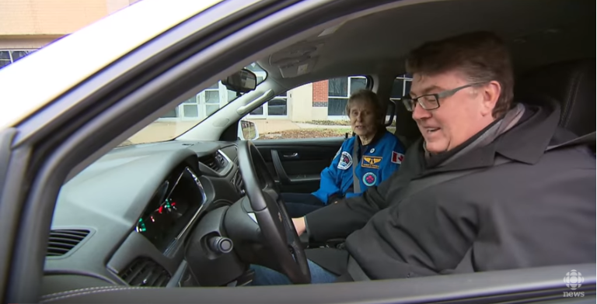
Dr. Bondar on Photography

Slide 14
Who are you Dr. Roberta Bondar? – In conversation

Slide 15
On Art at the AGO

Slide 16
Canada 150 Honors

