Slide 2
Lecture #3 – Soccer and Politics
National Identity/relevancy
Soccer Diplomacy
Force for Evil – Ideology
Wars and conflicts
Major Disasters
Most shocking Moments

Slide 3
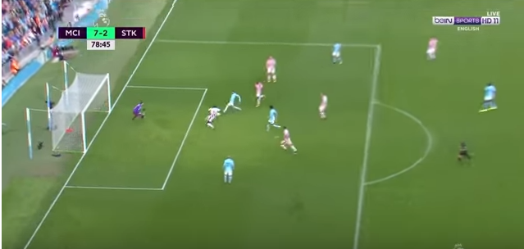
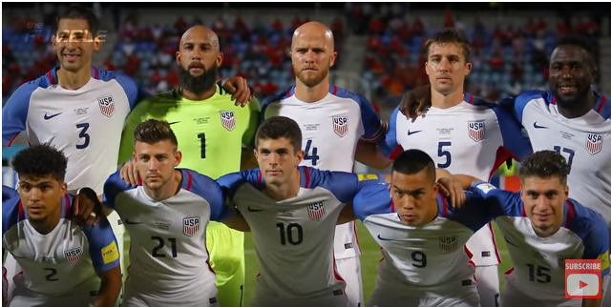
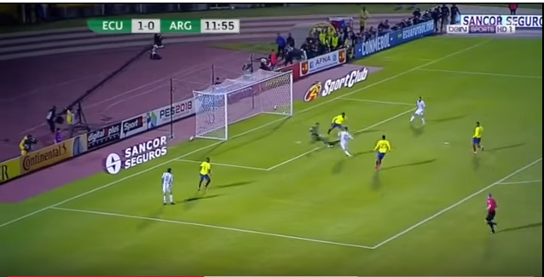
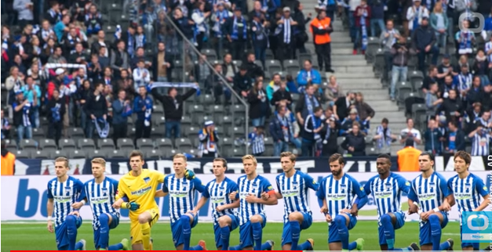
LAST WEEK TODAY…
PERVASIVE INEQUALITIES – BIG MONEY TALKS
BARCELONA, MANCHESTER CITY, PSG , MANCHESTER U. ATTACK WINS, DEFENCE SUSTAINS
USA MISSES QUALIFYING FOR THE 2018 WORLD CUP
LOSING 2:1 TO TRINIDAD & TOBAGO.
https://www.youtube.com/watch?v=BEAxG1QiCMY&t=13s
ARGENTINA MADE IT TO THE 2018 WORLD CUP.
LIONEL MESSI DID IT ALMOST SINGLE HANDADLEY
WHAT’S GERMANY GOT TO DO WITH IT?!

Slide 4
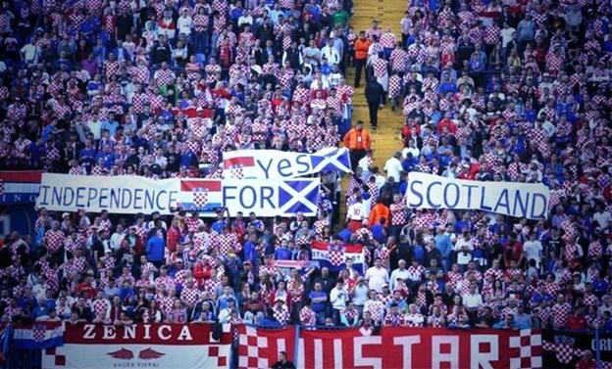
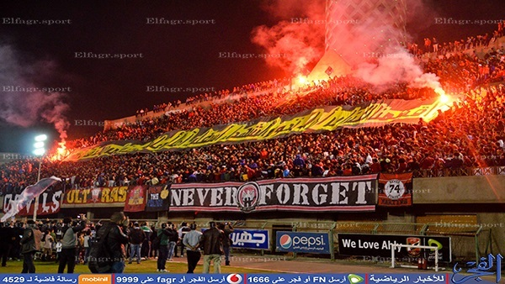
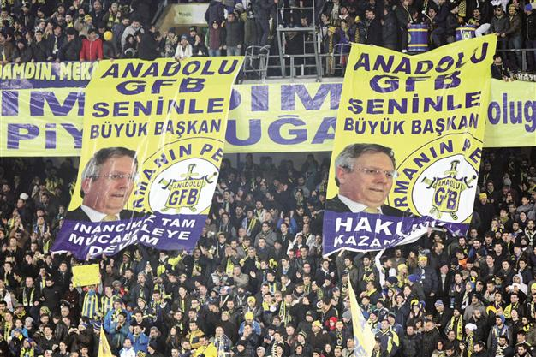
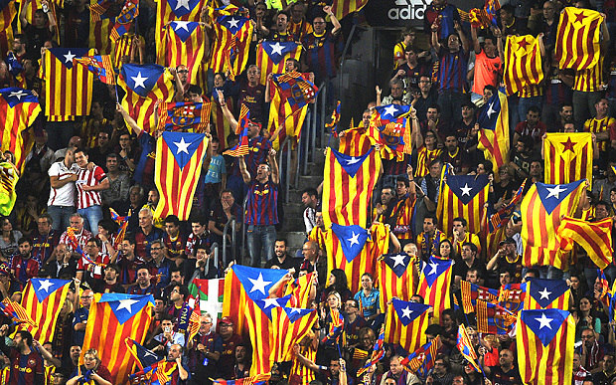
FOOTBALL & POLITICS

Slide 5
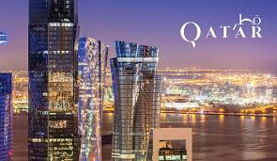
International Relevance
Human Rights Abuse

Slide 6
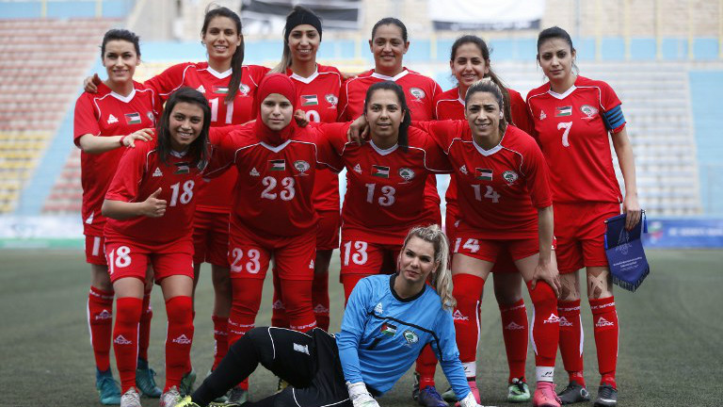
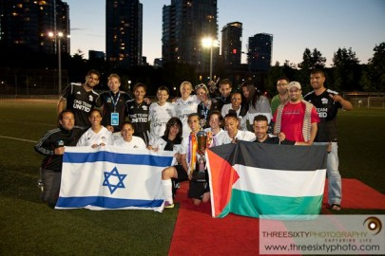
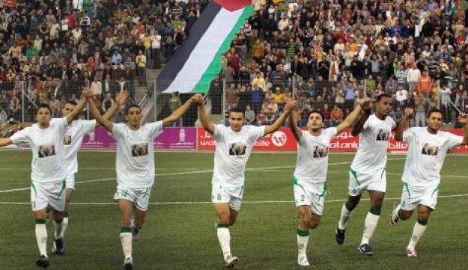
National Identity
Gender Equality

Slide 7
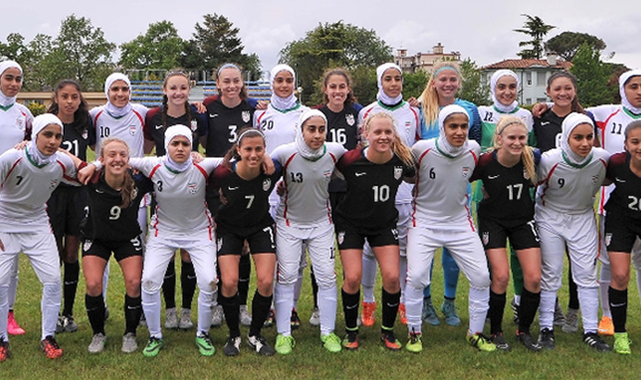
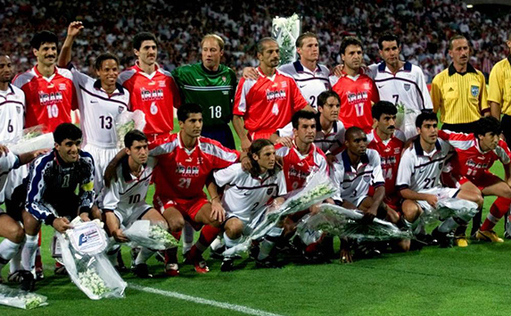
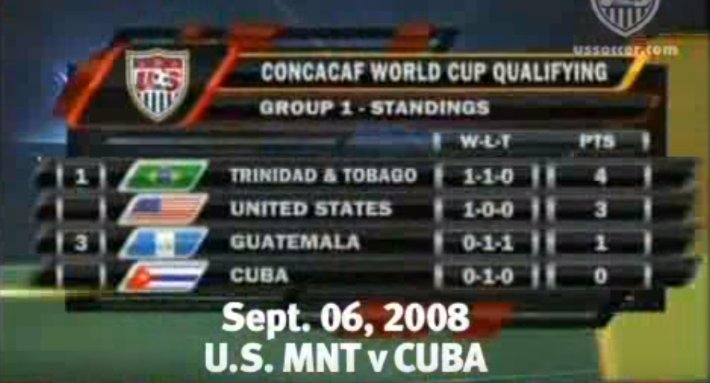
April 2016
“Ping Pong” Diplomacy
June, 1998

Slide 8
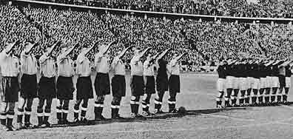
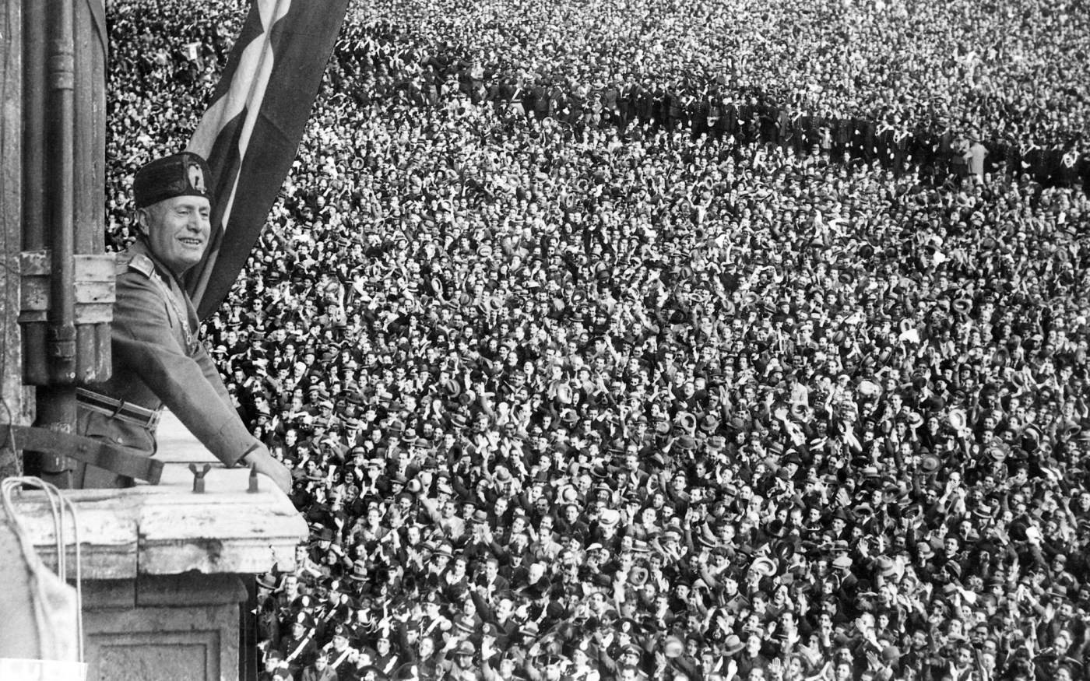
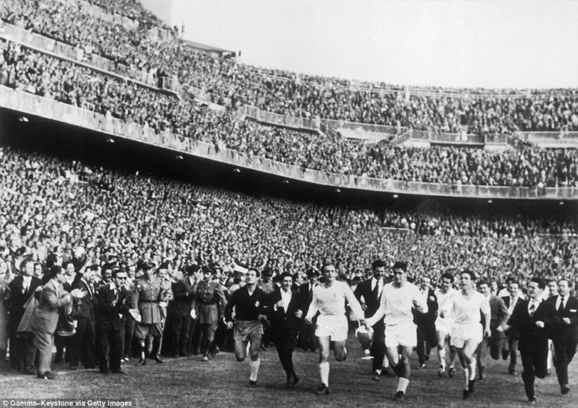
1938
FORCE FOR EVIL - IDEOLOGY
.

Slide 9
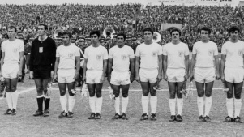
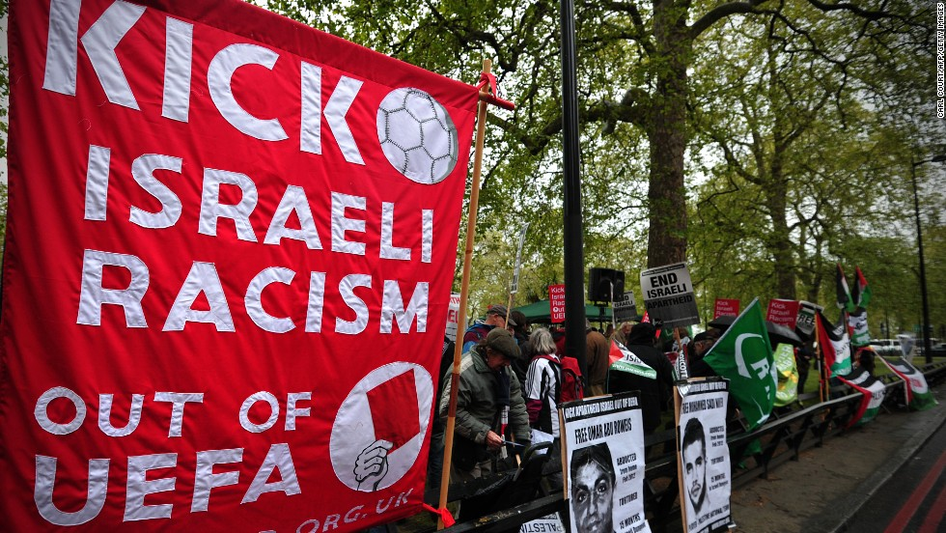
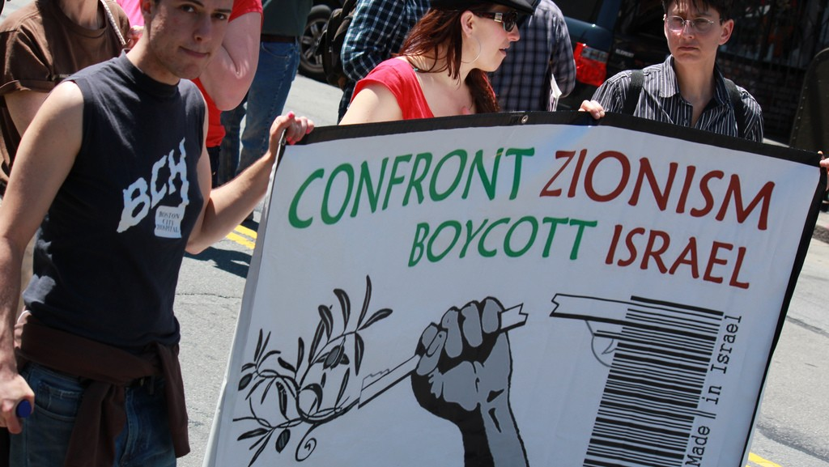
Israel began competing in the Asian Football Confederation (AFC) in 1954 despite significant opposition from Arab &Muslim nations. In 1982 it began playing in UEFA
1970
Political Boycott & Sanctions

Slide 10
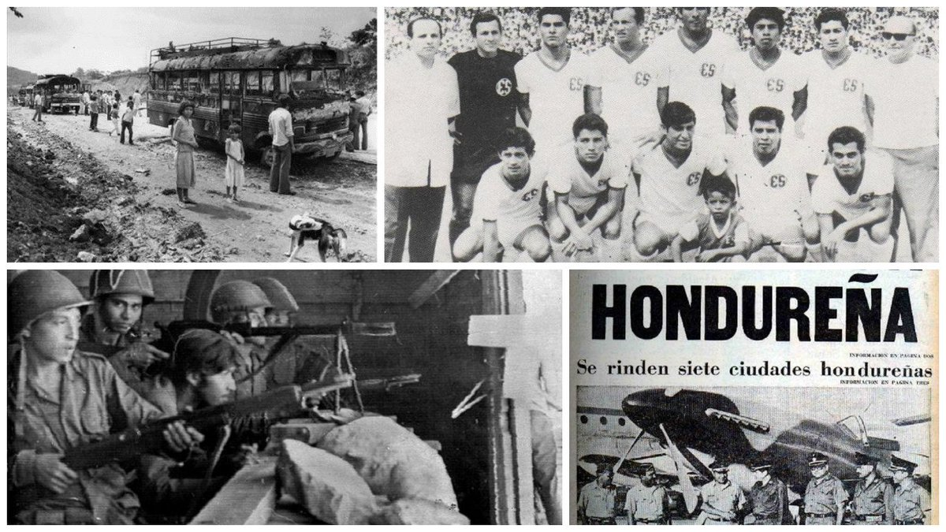
A four day war, known as the "Soccer War", was fought between El Salvador and Honduras

Slide 11
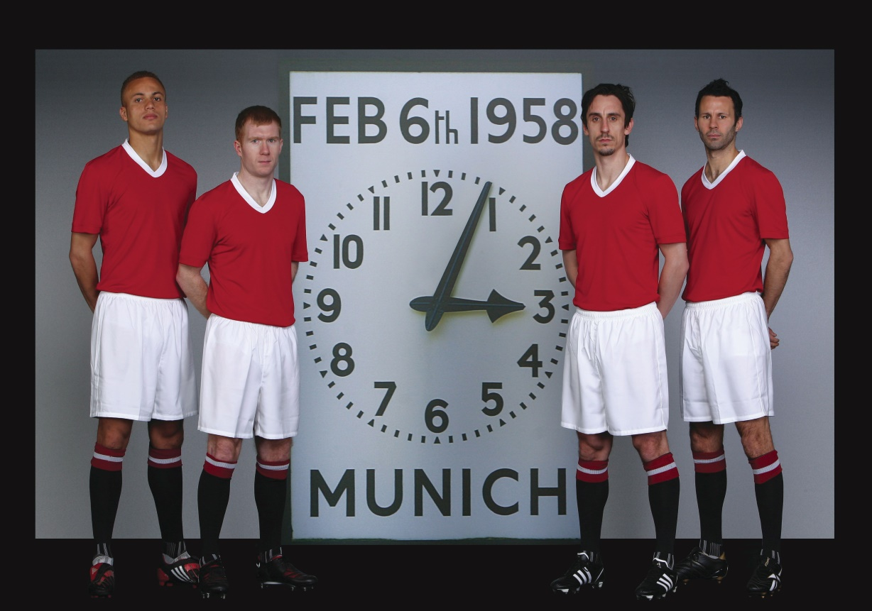
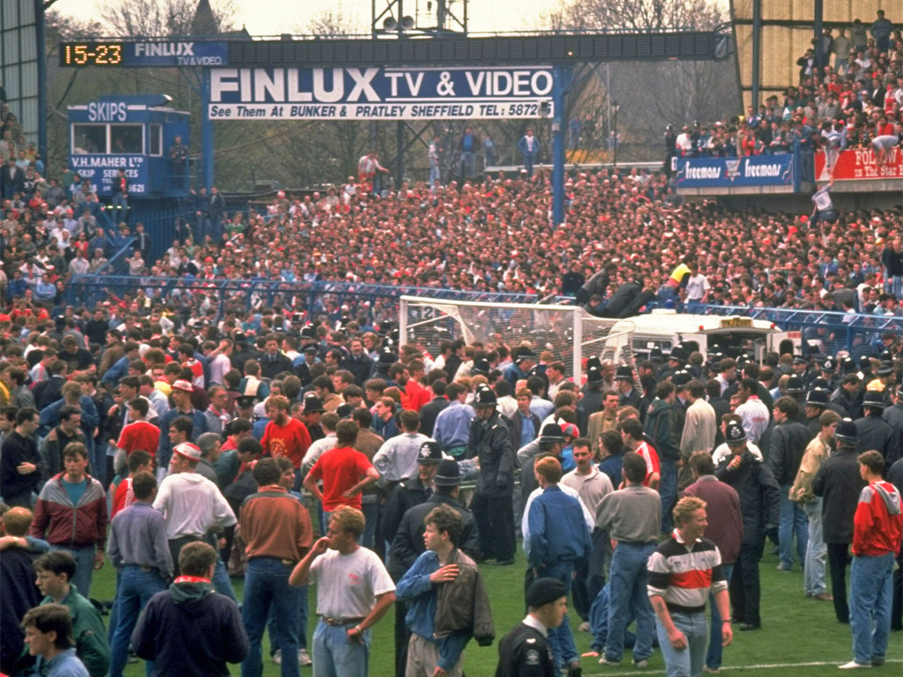
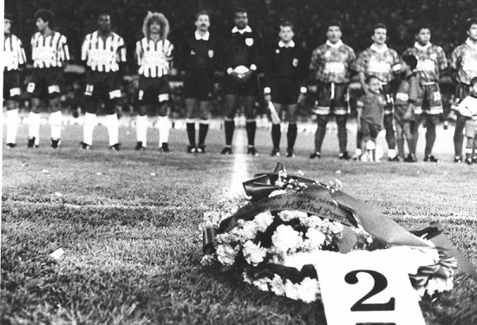
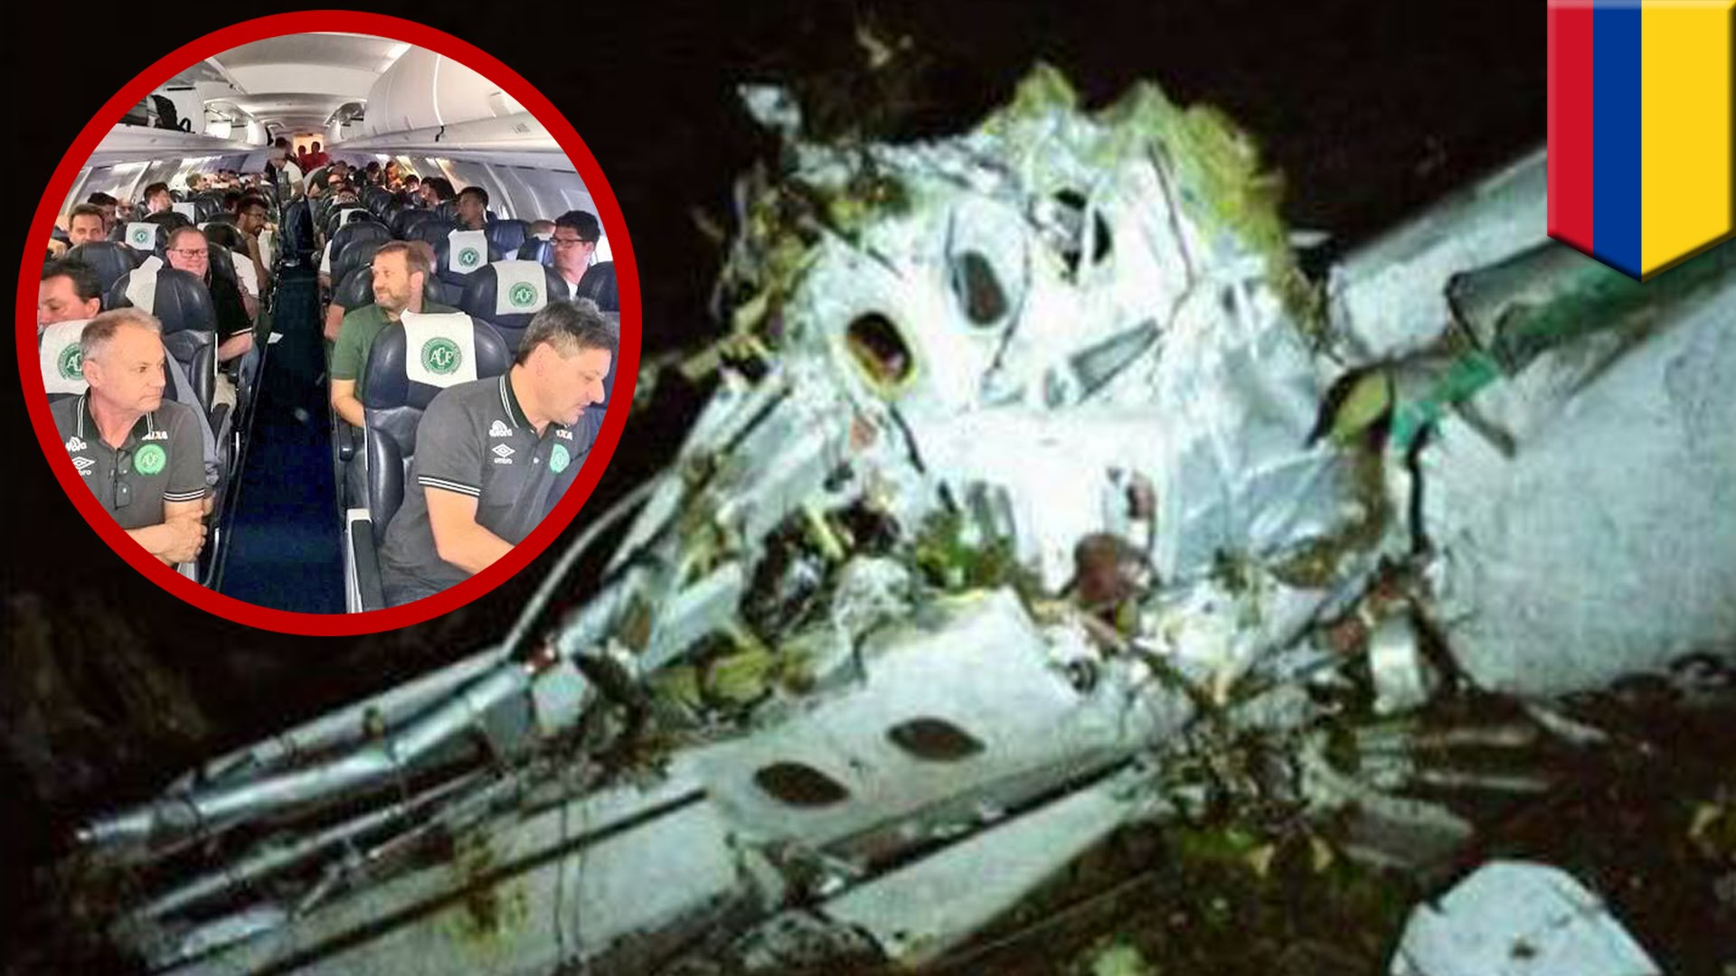
DISASTERS

Slide 13
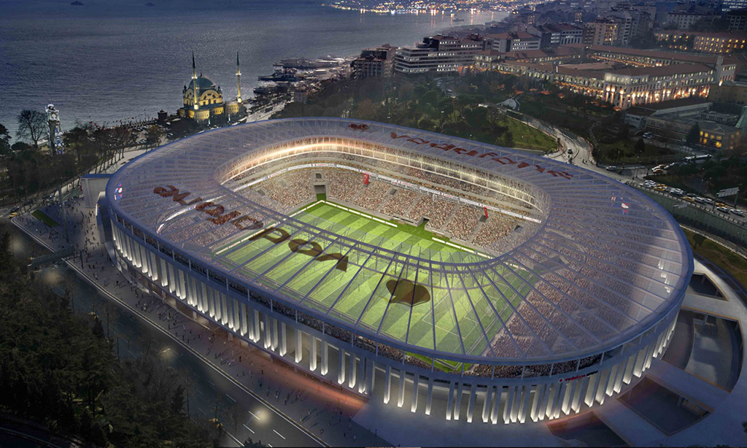
SILLY FUN

Slide 14
Next Week
Football Governance – FIFA
Scandals, Corruption, Arrests
A New beginning - Reforms

