Slide 2
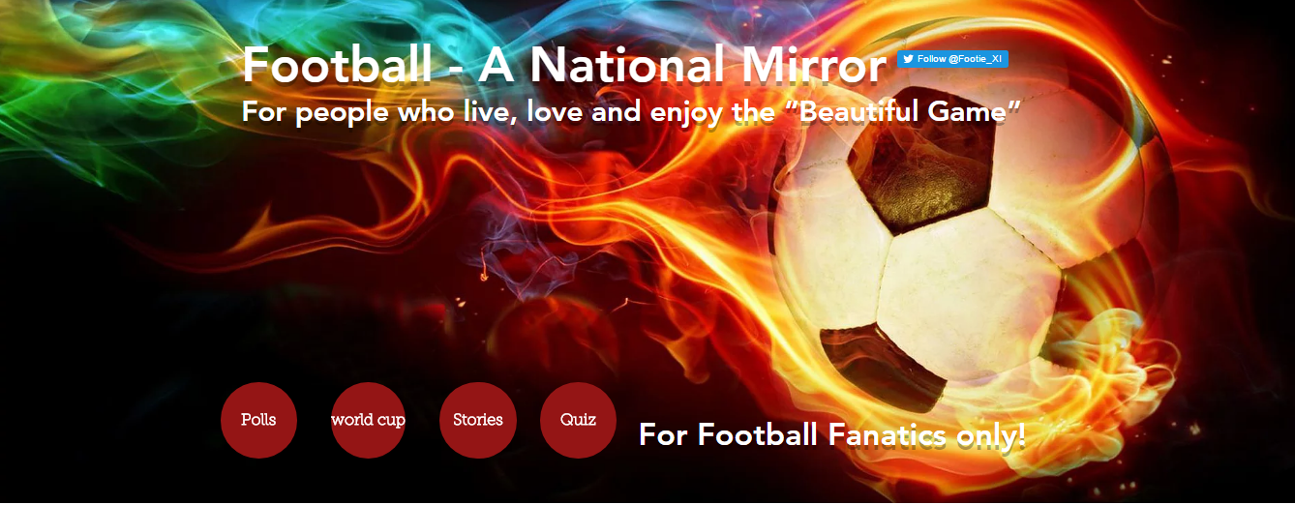
Lecture #5 – Heroes and Villains
What’s a HERO
What’s a VILAIN?
The Villain’s Stories
The Hero’s Stories

Slide 3
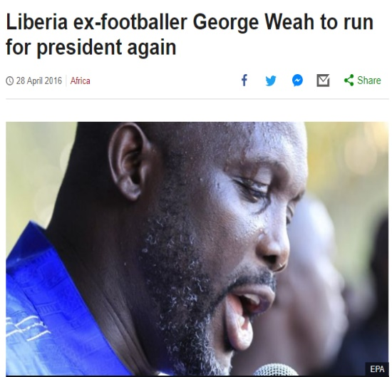
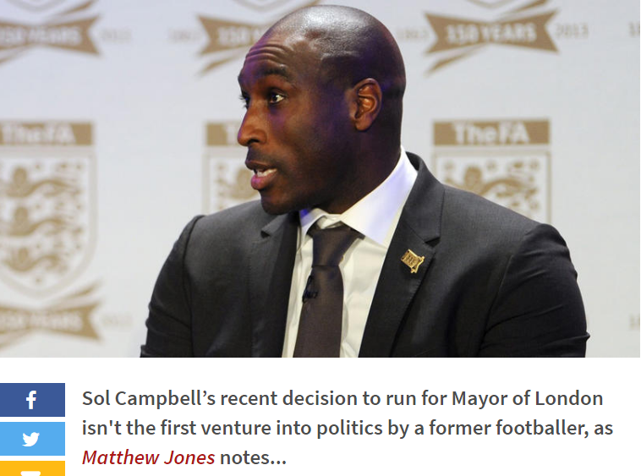
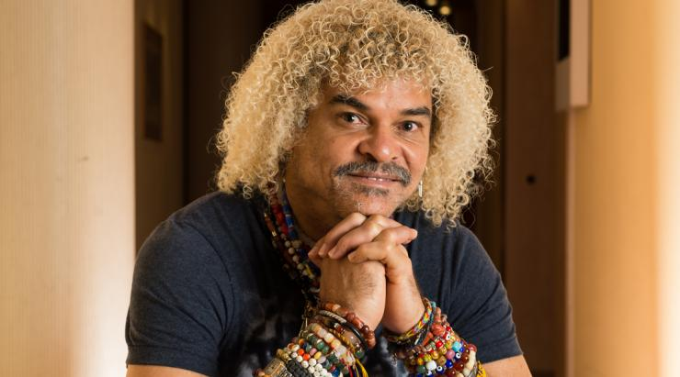
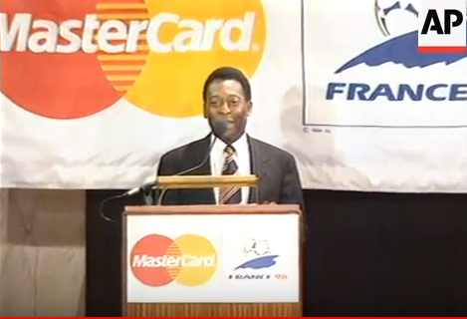
Last Week Today
The iconically-coiffed Carlos Valderamma standing as a candidate in the national elections. Representing the U Party

Slide 4
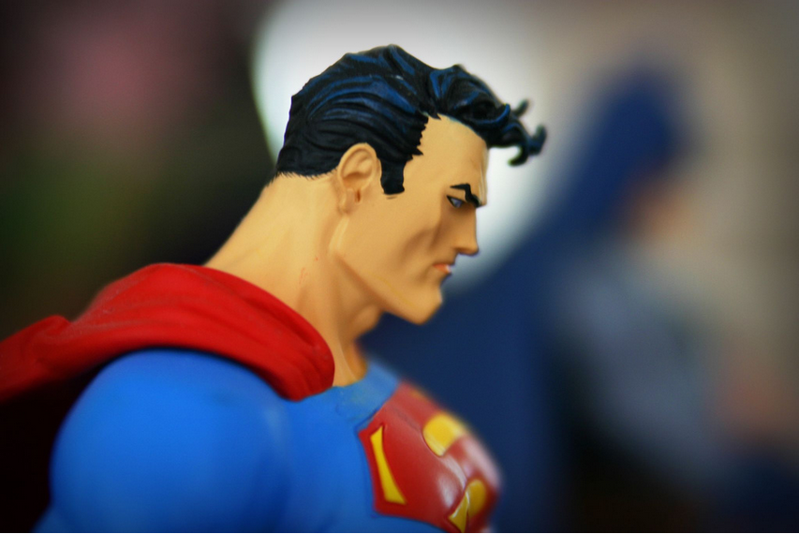
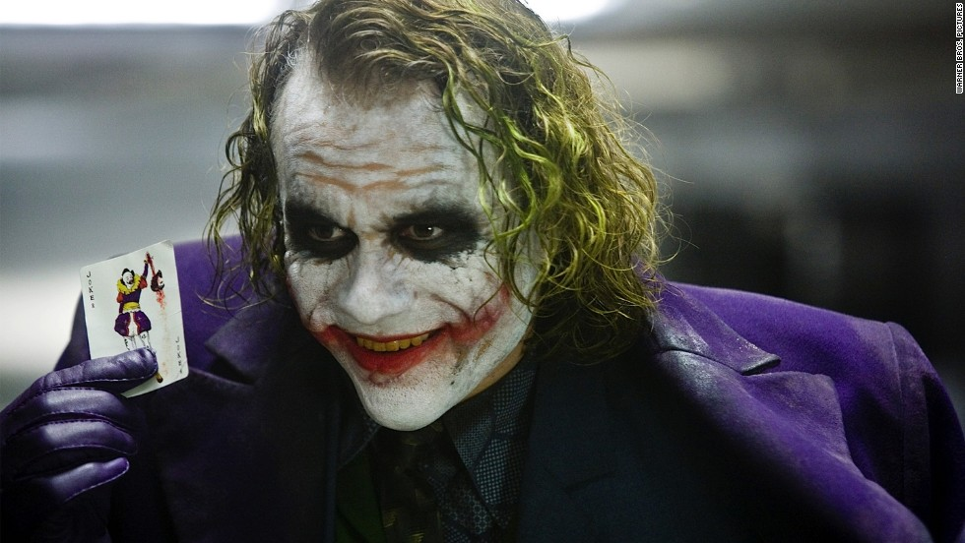
What’s/Who is a HERO
What’s/Who is a VILLAN

Slide 5
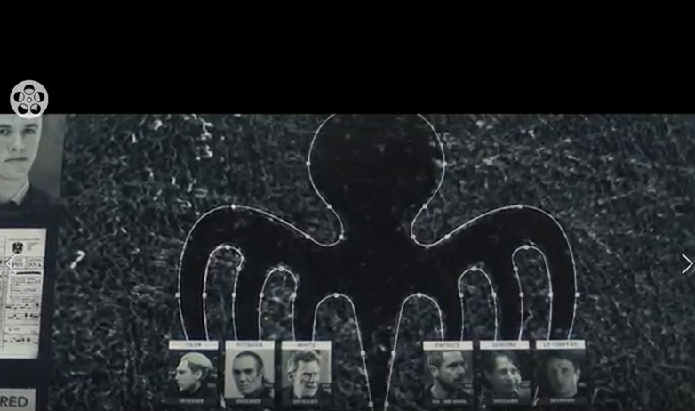
Is James Bond a Hero or a Villain?

Slide 6
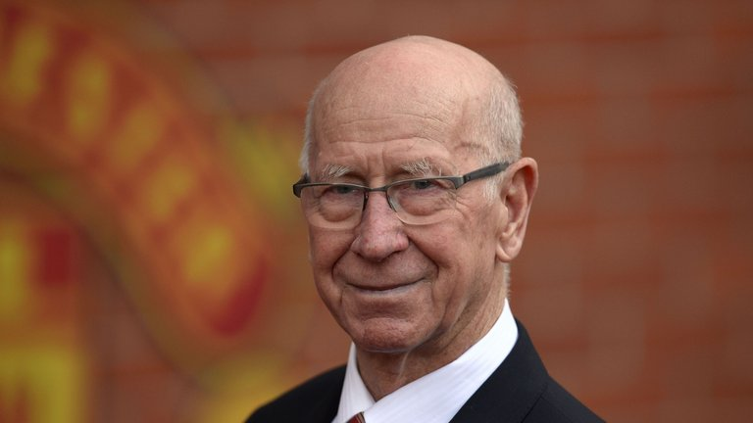
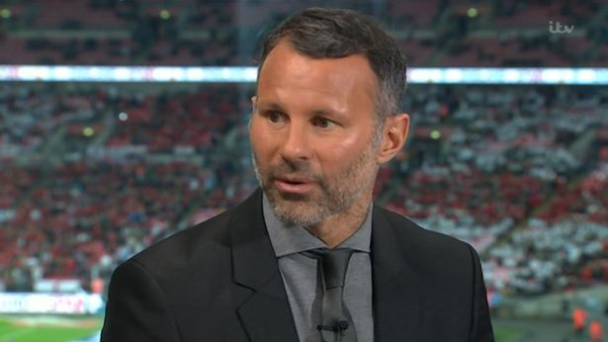
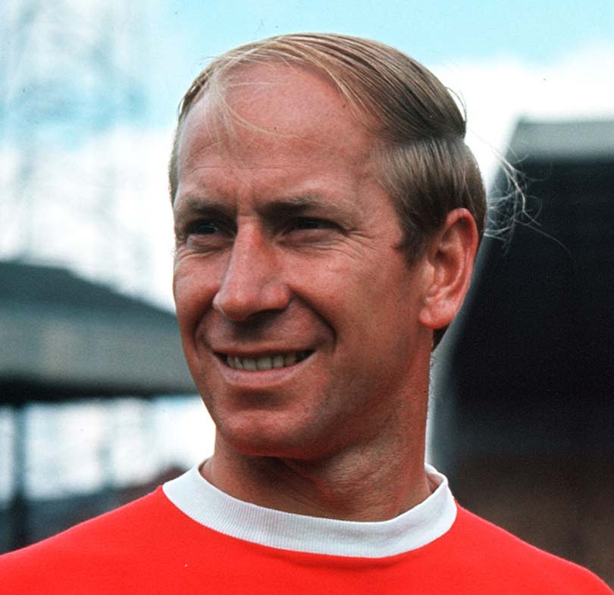
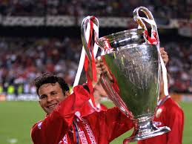
Great at what they do! ones who are heroic away from their respective sport, the ones who sacrifice their time, money, and sometimes even personal well-being for the betterment of others, Someone we would aspire to be like that are actually worthy of our admiration.

Slide 7
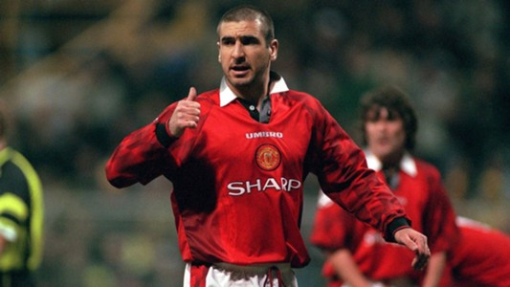
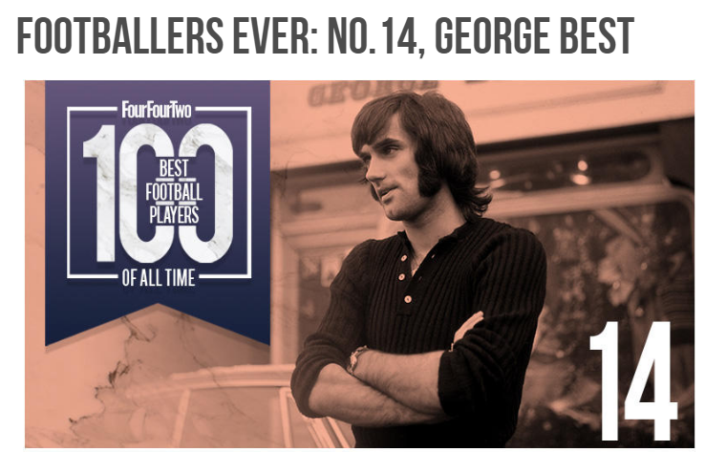
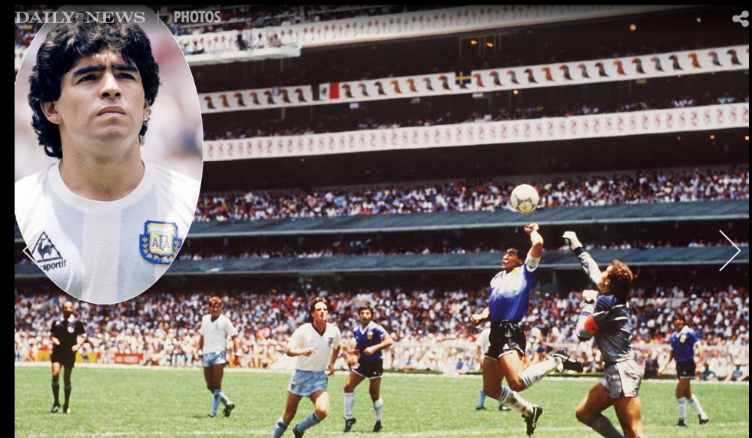
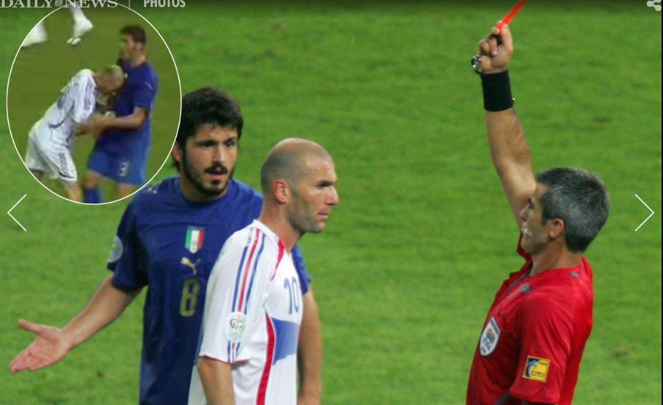
Every hero needs a villain and soccer certainly has its fair share of them.
Great talents and masters of their craft but they are also …
cheats, traitors, racists and egos that are loved by many and reviled by many more.
A great villain should capture the attention of the world through what they have done

Slide 8
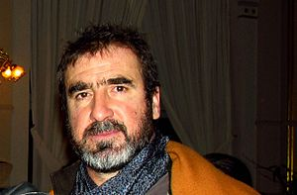
ERIC CANTONA - Manchester United 1992-1997 French National Team 1987-1995
A large, physically strong, hard-working, and tenacious forward, who combined technical skill and creativity with power and goalscoring ability, Cantona is often regarded as having played a key role in the revival of Manchester United as a footballing force in the 1990s and having an iconic status at the club. He wore the number 7 shirt at Manchester United with his trademark upturned collar.

Slide 9
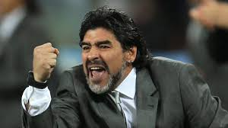
Diego Maradona
Argentine retired professional footballer. He has served as a manager and coach at other clubs as well as the national team of Argentina. Many in the sport, including football writers, players, and fans, regard Maradona as the greatest football player of all time. He was joint FIFA Player of the 20th Century with Pelé
.

Slide 10
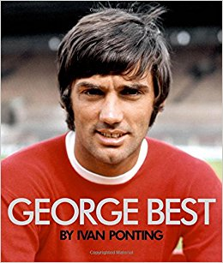
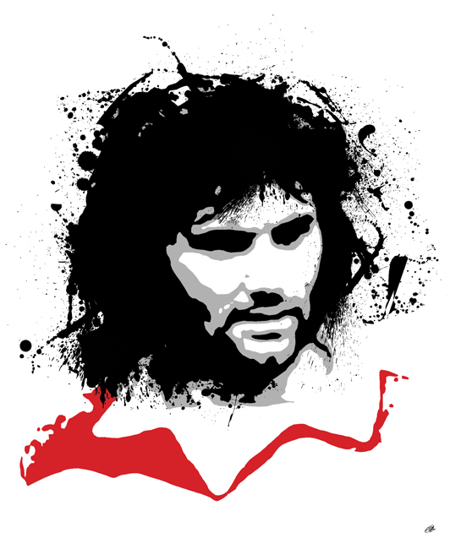
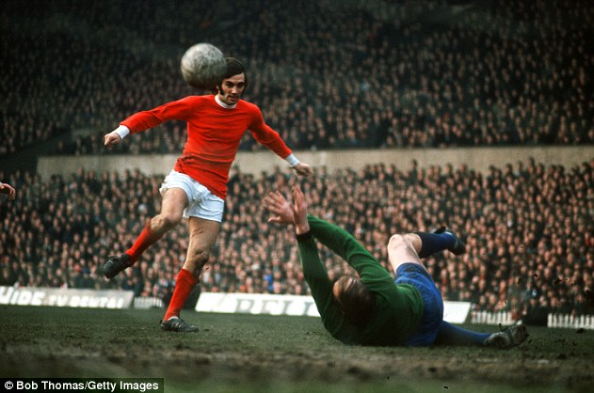
George Best
Northern Irish professional footballer who played as a winger for Manchester United and the Northern Ireland national team. In 1968, he won the European Cup with Manchester United, and was named the European Footballer of the Year and FWA Footballer of the Year. The Irish Football Association described him as the "greatest player to ever pull on the green shirt of Northern Ireland".
.

Slide 11
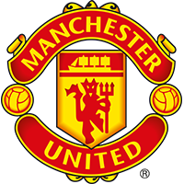
Ryan Giggs- Manchester United 1992-2014 most decorated player in football history
.
Appearance | 632
Goals | 109
Assists | 162
13
Championships
1992-2014 (19-41)
During his time at United, he won 13 Premier League winner's medals, four FA Cup winner's medals, three League Cup winner's medals, two UEFA Champions League winner's medals, a FIFA Club World Cup winners medal, an Intercontinental Cup winner's medal, a UEFA Super Cup winner's medal and nine FA Community Shield winner's medals. Giggs captained the team on numerous occasions

Slide 12
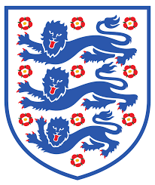
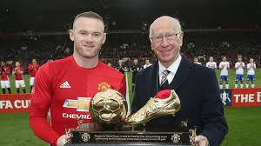
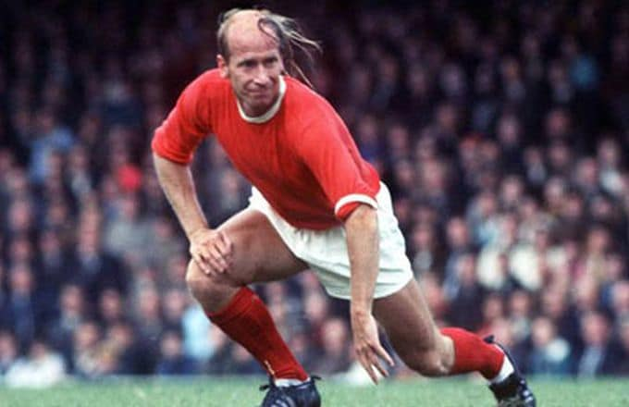
Bobby Charlton - Manchester United 1960’s Most feared English goal scorer - 249
.
Regarded as one of the greatest midfielders of all time, and an essential member of the England team who won the World Cup in 1966, the year he also won the Ballon d'Or. He played almost all of his club football at Manchester United, where he became renowned for his attacking instincts and passing abilities from midfield and his ferocious long-range shot.

Slide 13
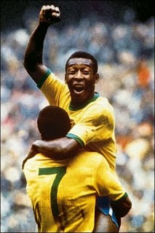
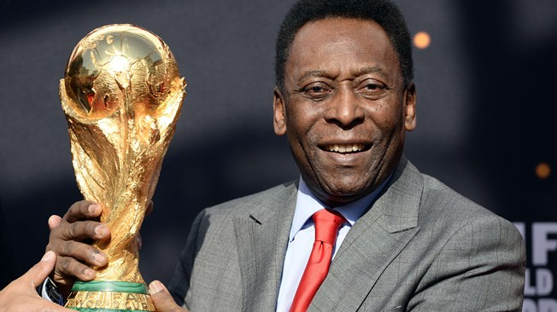
My Inspirational Hero – PELE’

Slide 14
Next Week
Football Governance - FIFA
Corruption & Scandals
A New Era – Reforms
Football as a force for good in the world?

