Slide 1
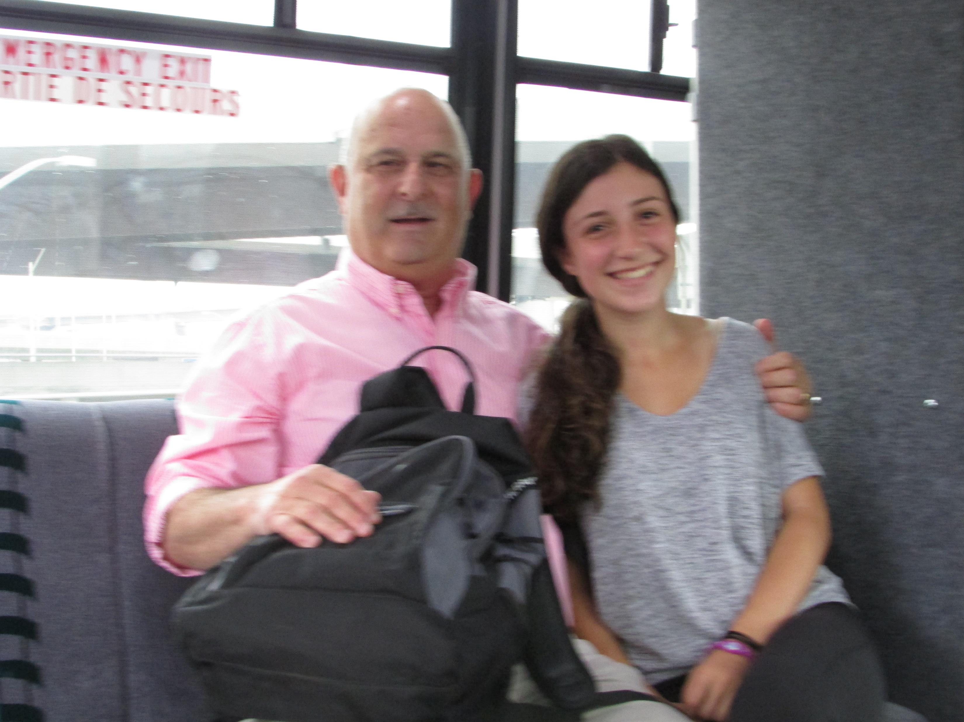
Dear Erin: I am watching you with pride and joy. My first and special grand daughter is graduating this year and already practicing her interests in not one but two companies. Best and continuing luck in 2021 and beyond. Remember what I wrote to you when you were only 4. Your love of family and your kindness are my inspiration. I love you, Sabba

Slide 2
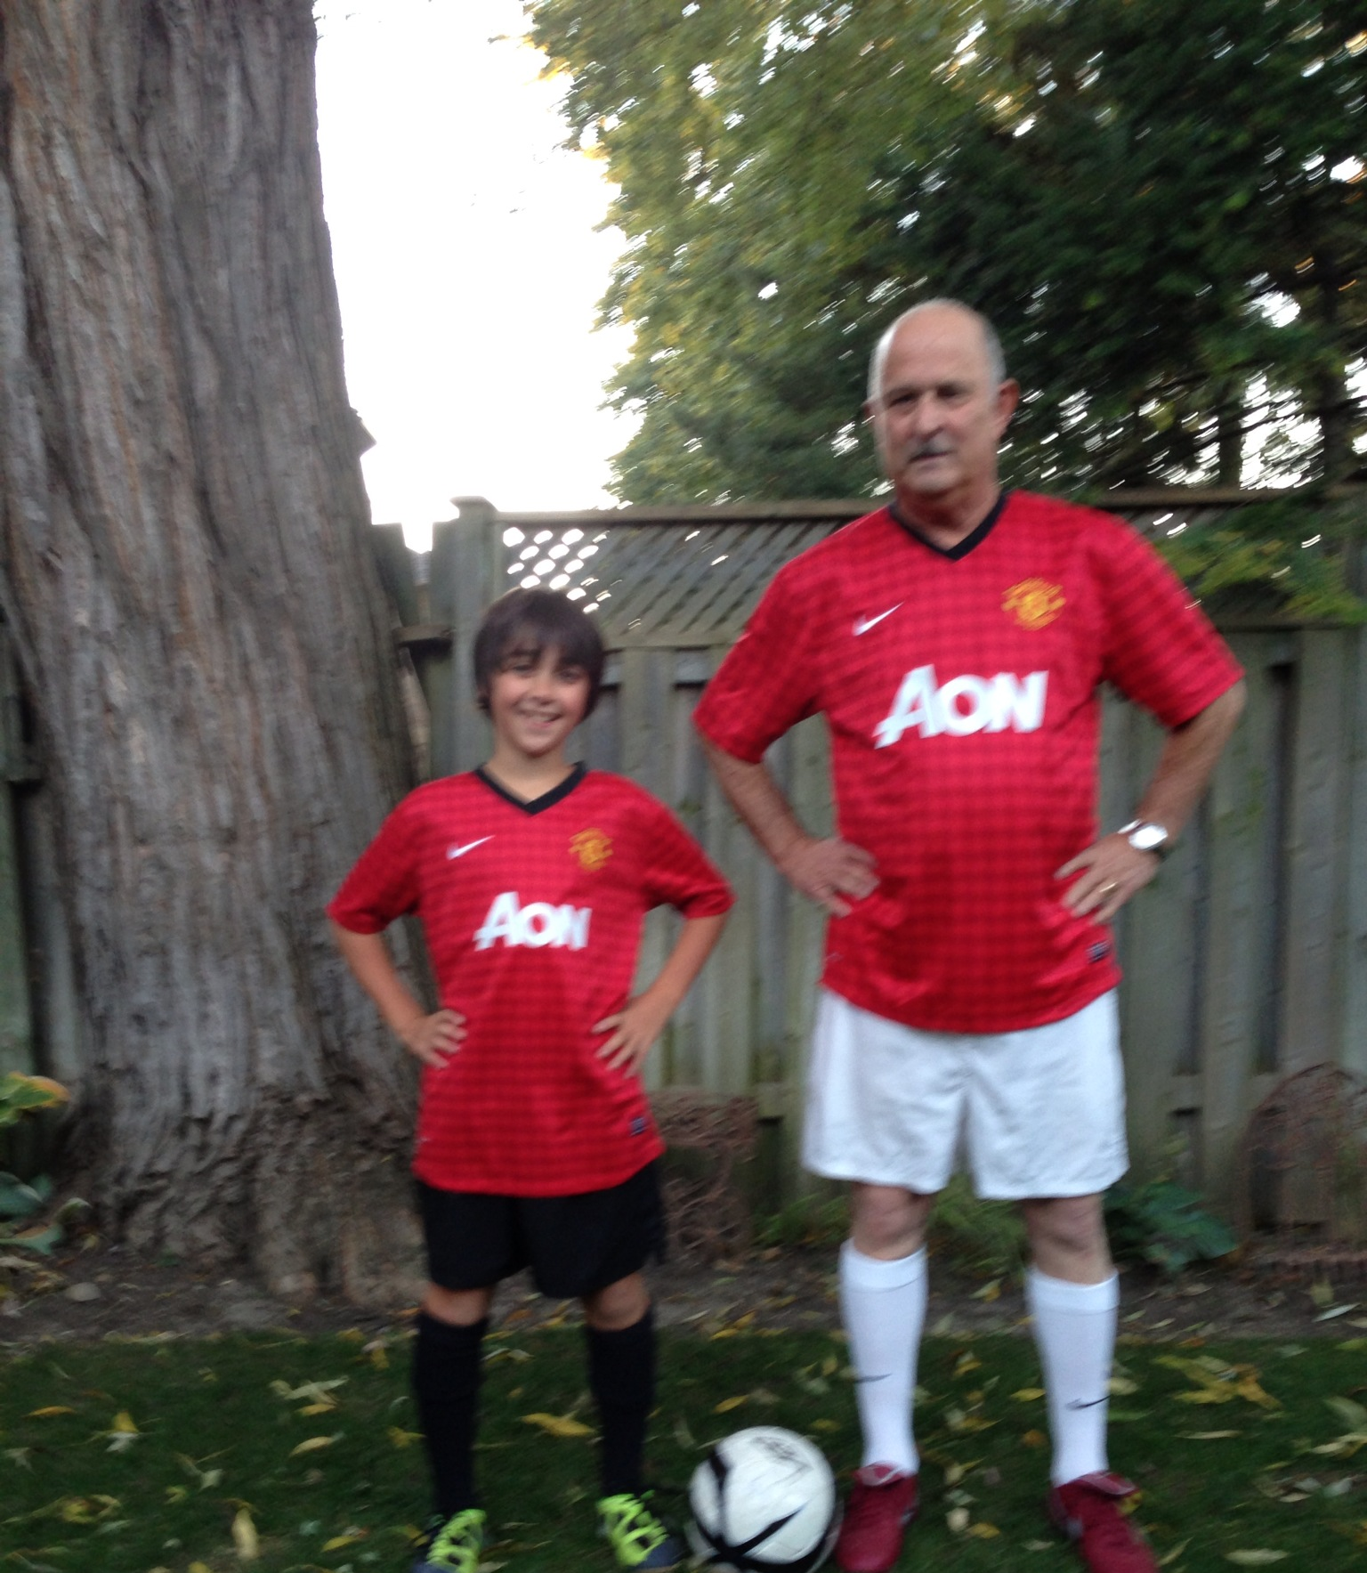
Dear Ethan: I stand beside you grinning with pride and joy. You are a model for me as I wrote to you when you were only 4 – I wanna be like you! Smart, cool, fun, successful, considerate, loving and altogether a Mench. Good luck in the new year and moving up in the world.
I love you, Sabba

Slide 3
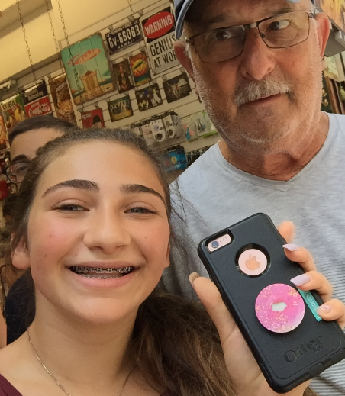
To Jacklyn:
Wow you are already graduating this year! So proud of you that you have already been (early) accepted to university and that you discovered your interest and passion. I only have one picture with you (why?) but I keep it close to my heart. I wish you all the luck and success in 2021 and beyond and I am so thrilled that you connected with Israel and what it represents. Remember what I wrote for you when you were only 3 or 4?
I love you, Sabba

Slide 4
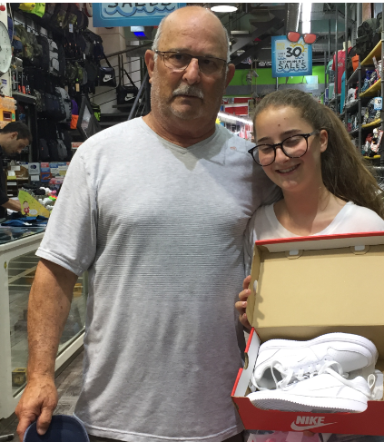
To Emily:
It didn’t take much time to discover how great you really are. I am watching you with pride and admiration of your pursuit of excellence, your kindness, your wit, your sense of humor and your independence. You turned out just the way I thought of you when you were only 3.
I love you, Sabba

Slide 5
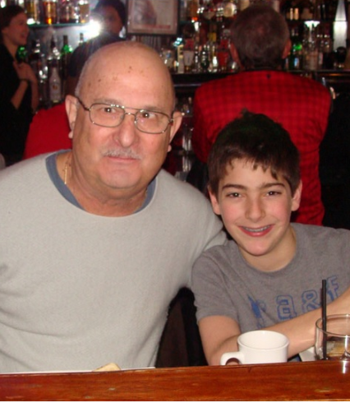
To Zachary:
If I said I envy you I will not be exaggerating. You found your calling and you embraced it with passion and focus. It takes most people much longer to do it if at all. As I wrote to you when you were only 3 or 4 “Imagination is your name, it’s yours and it will take you far and far away.” But most of all I love your heart of gold, your sensitivity and kindness.
I love you, Sabba

Slide 6
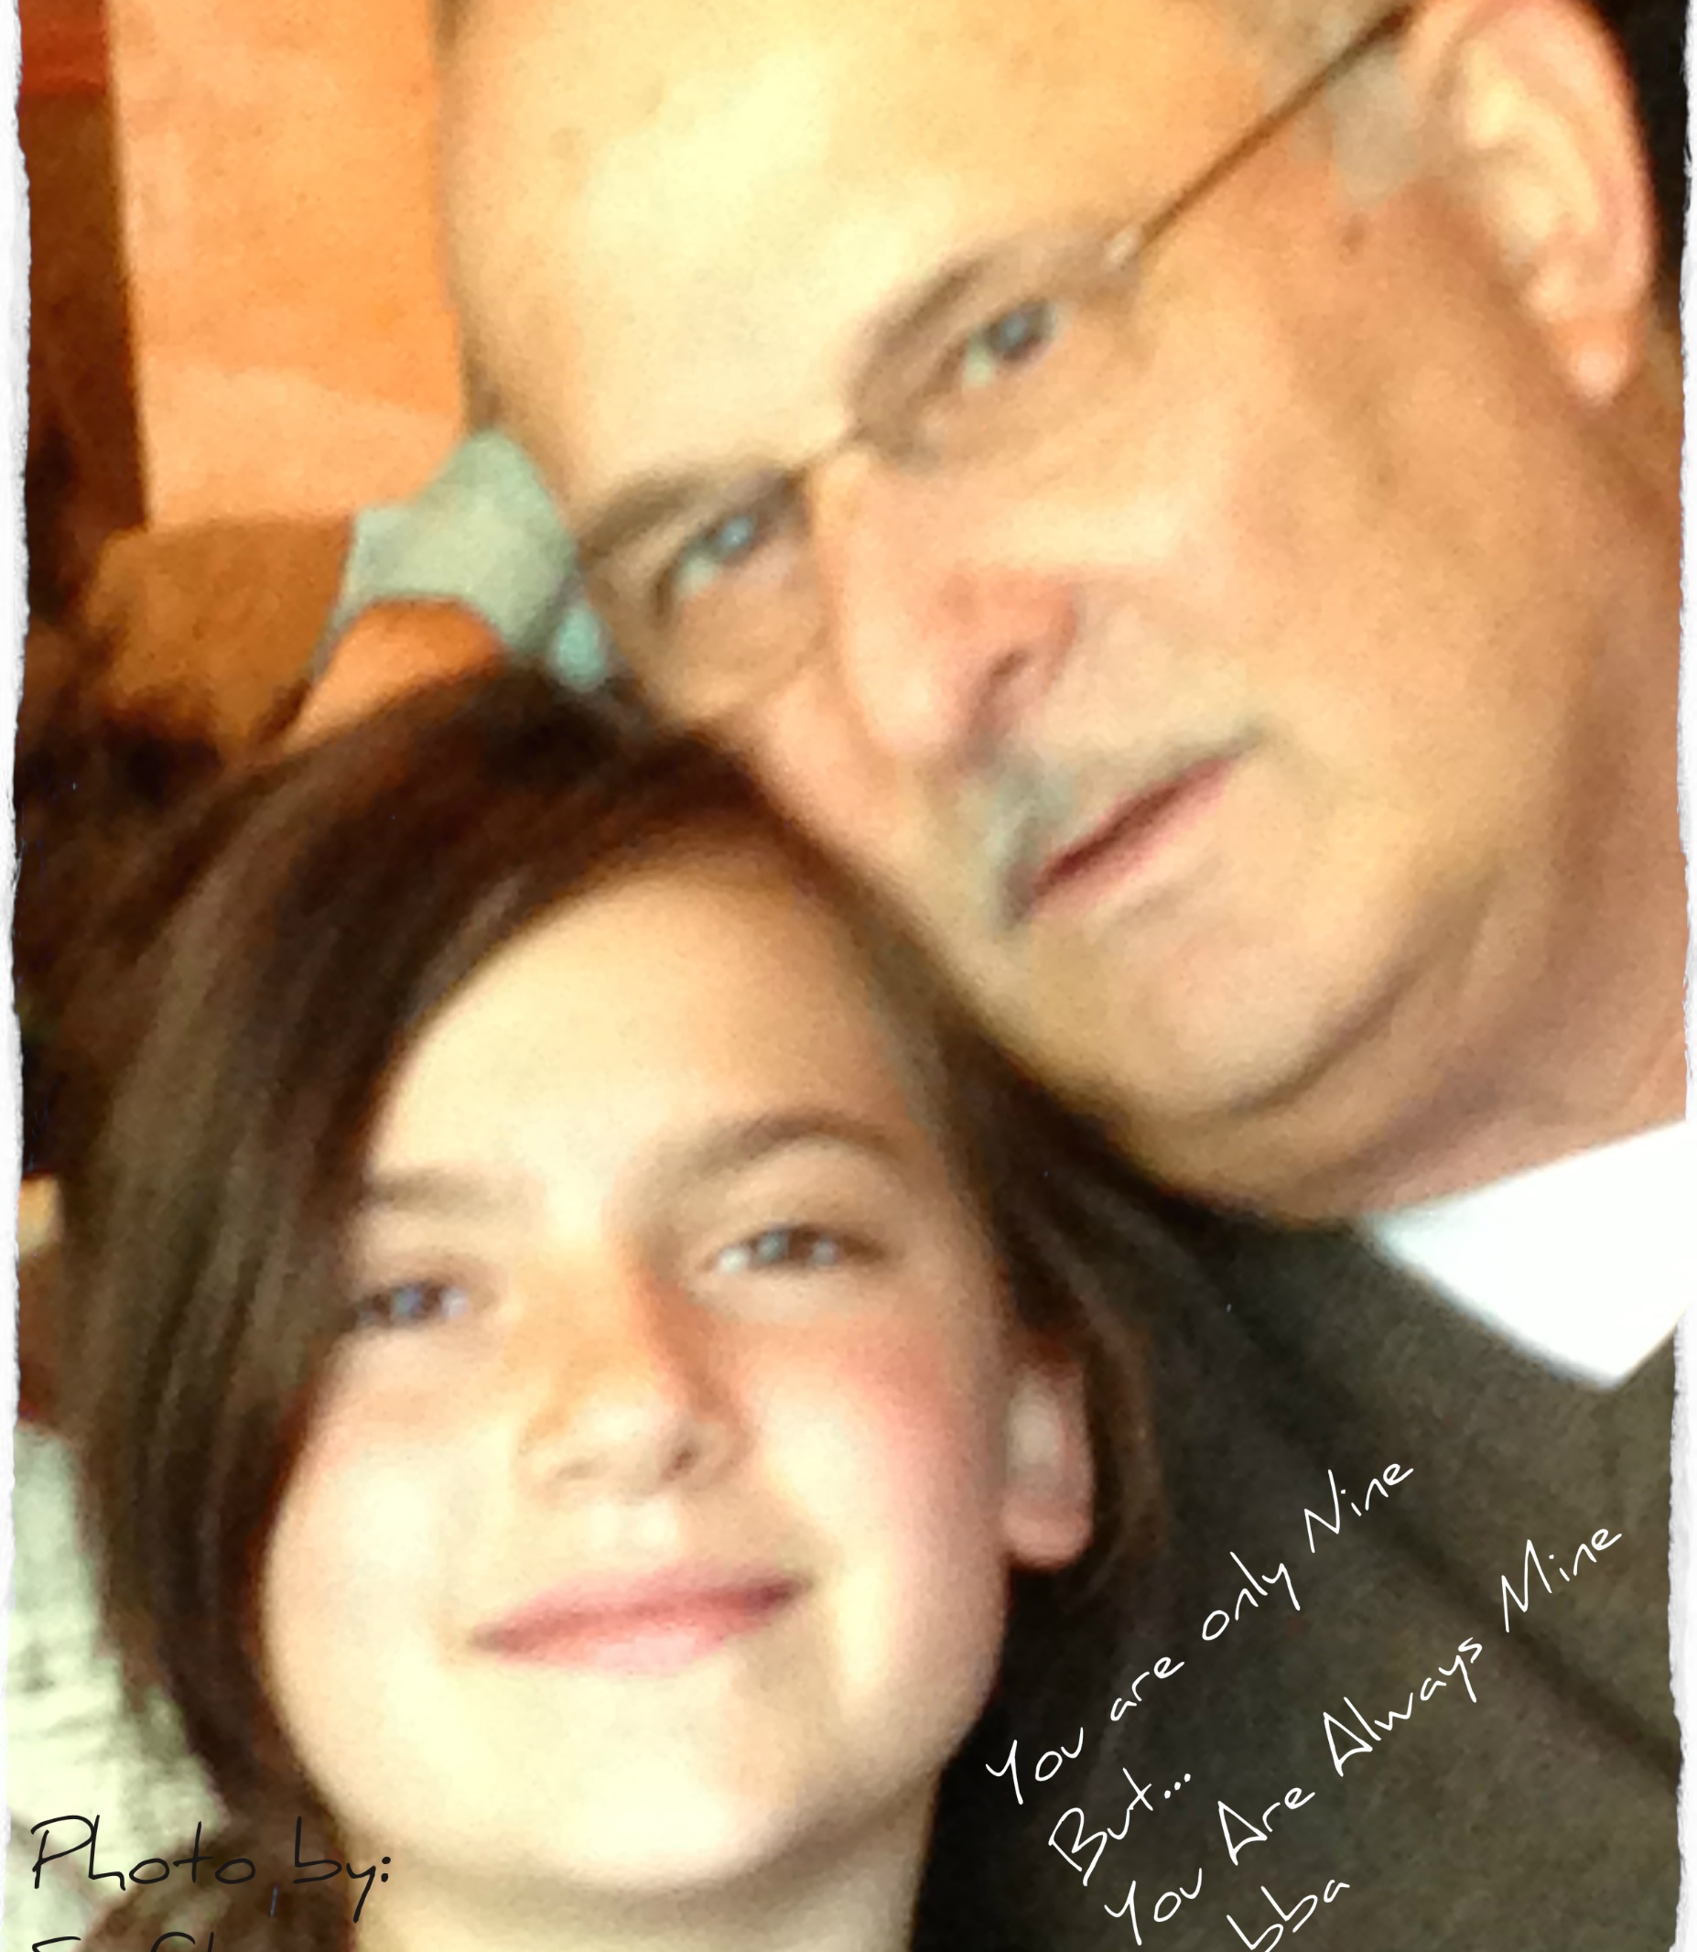
To Jaime:
Remember how early in your life you signed your way into my heart? It is then that my love and admiration for you just grew and grew. As I told you many times you are awesome. Your search for excellence, your consideration for others, your smarts and unbelievable maturity mystifies me. Always reach for the stars you have what it takes to get there.
I love you, Sabba

Slide 7
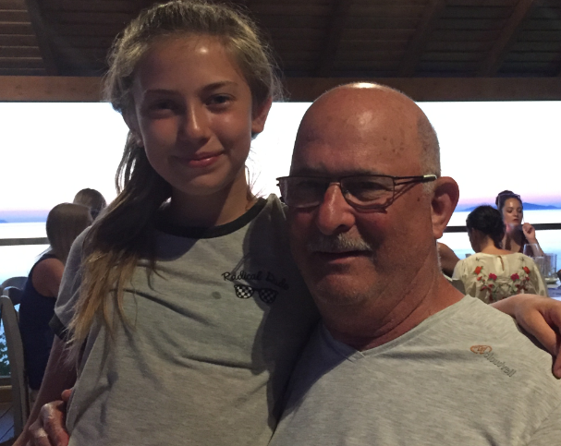
To Alexandra:
You’re not only my landlord. You are my sunshine. Your wit, your smarts, your sense of humor and your kindness are your gifts to me. As the tiny you’ll always have a special status. Its not only because of your wonderful qualities it’s simply math. “ So strong and willful do I see you as you grow. May you be so ever happy and may your spirit ever glow”
I love you, Sabba

