Slide 1
War & Peace
In The Middle East
This Week:
The Syrian Civil War & Canada’s Role in The Middle East
Guest Speaker: Annie Demirjian
Lecture #10

Slide 2
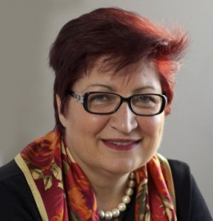
2014-2015 Director of Political Affairs & Mediation Group at the UN Mission in Somalia (UNSOM). She was responsible for the peace building and state building portfolio. including: military/civilian interface & stabilization, political reform, state formation (federal/state), conflict prevention & local reconciliation and constitutional review.
2004-2013, working with the UN Missions in the field, she headed UNDP’s Democratic Governance portfolio in Iraq, Libya, Somalia, Eastern European countries & Central Asia. At UNDP-Iraq (2004-2007), Somalia (2008-2009) and Libya (2011-2012) she was responsible for transitional administration, the constitution drafting process, elections, institutional development and capacity building, public administration reform, local governance and civil society development.
In 2010, she was seconded to Haiti to lead the Post Disaster Needs Assessment for the UNDP/World Bank after the earthquake in Haiti. Anne has 20 years of senior management experience, in policy and programming, with the Federal Government of Canada (central agencies/line departments, including at the Security Intelligence & Review Committee (SIRC).
For the United Nations and the World Bank she also worked in the following countries: Jordan, Egypt, Tunisia, Palestine Zimbabwe, South Africa and Nigeria.
Director, Glendon School of Public and International Affairs
York University

Slide 3
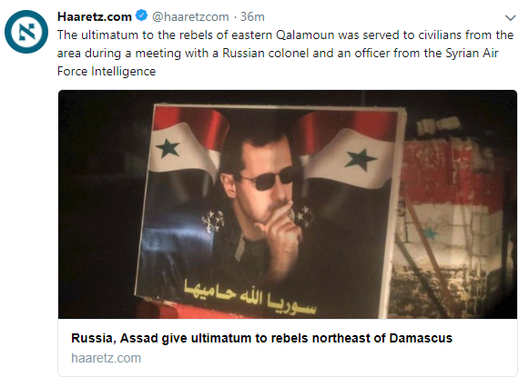

Slide 4
March of “Return”

Slide 5
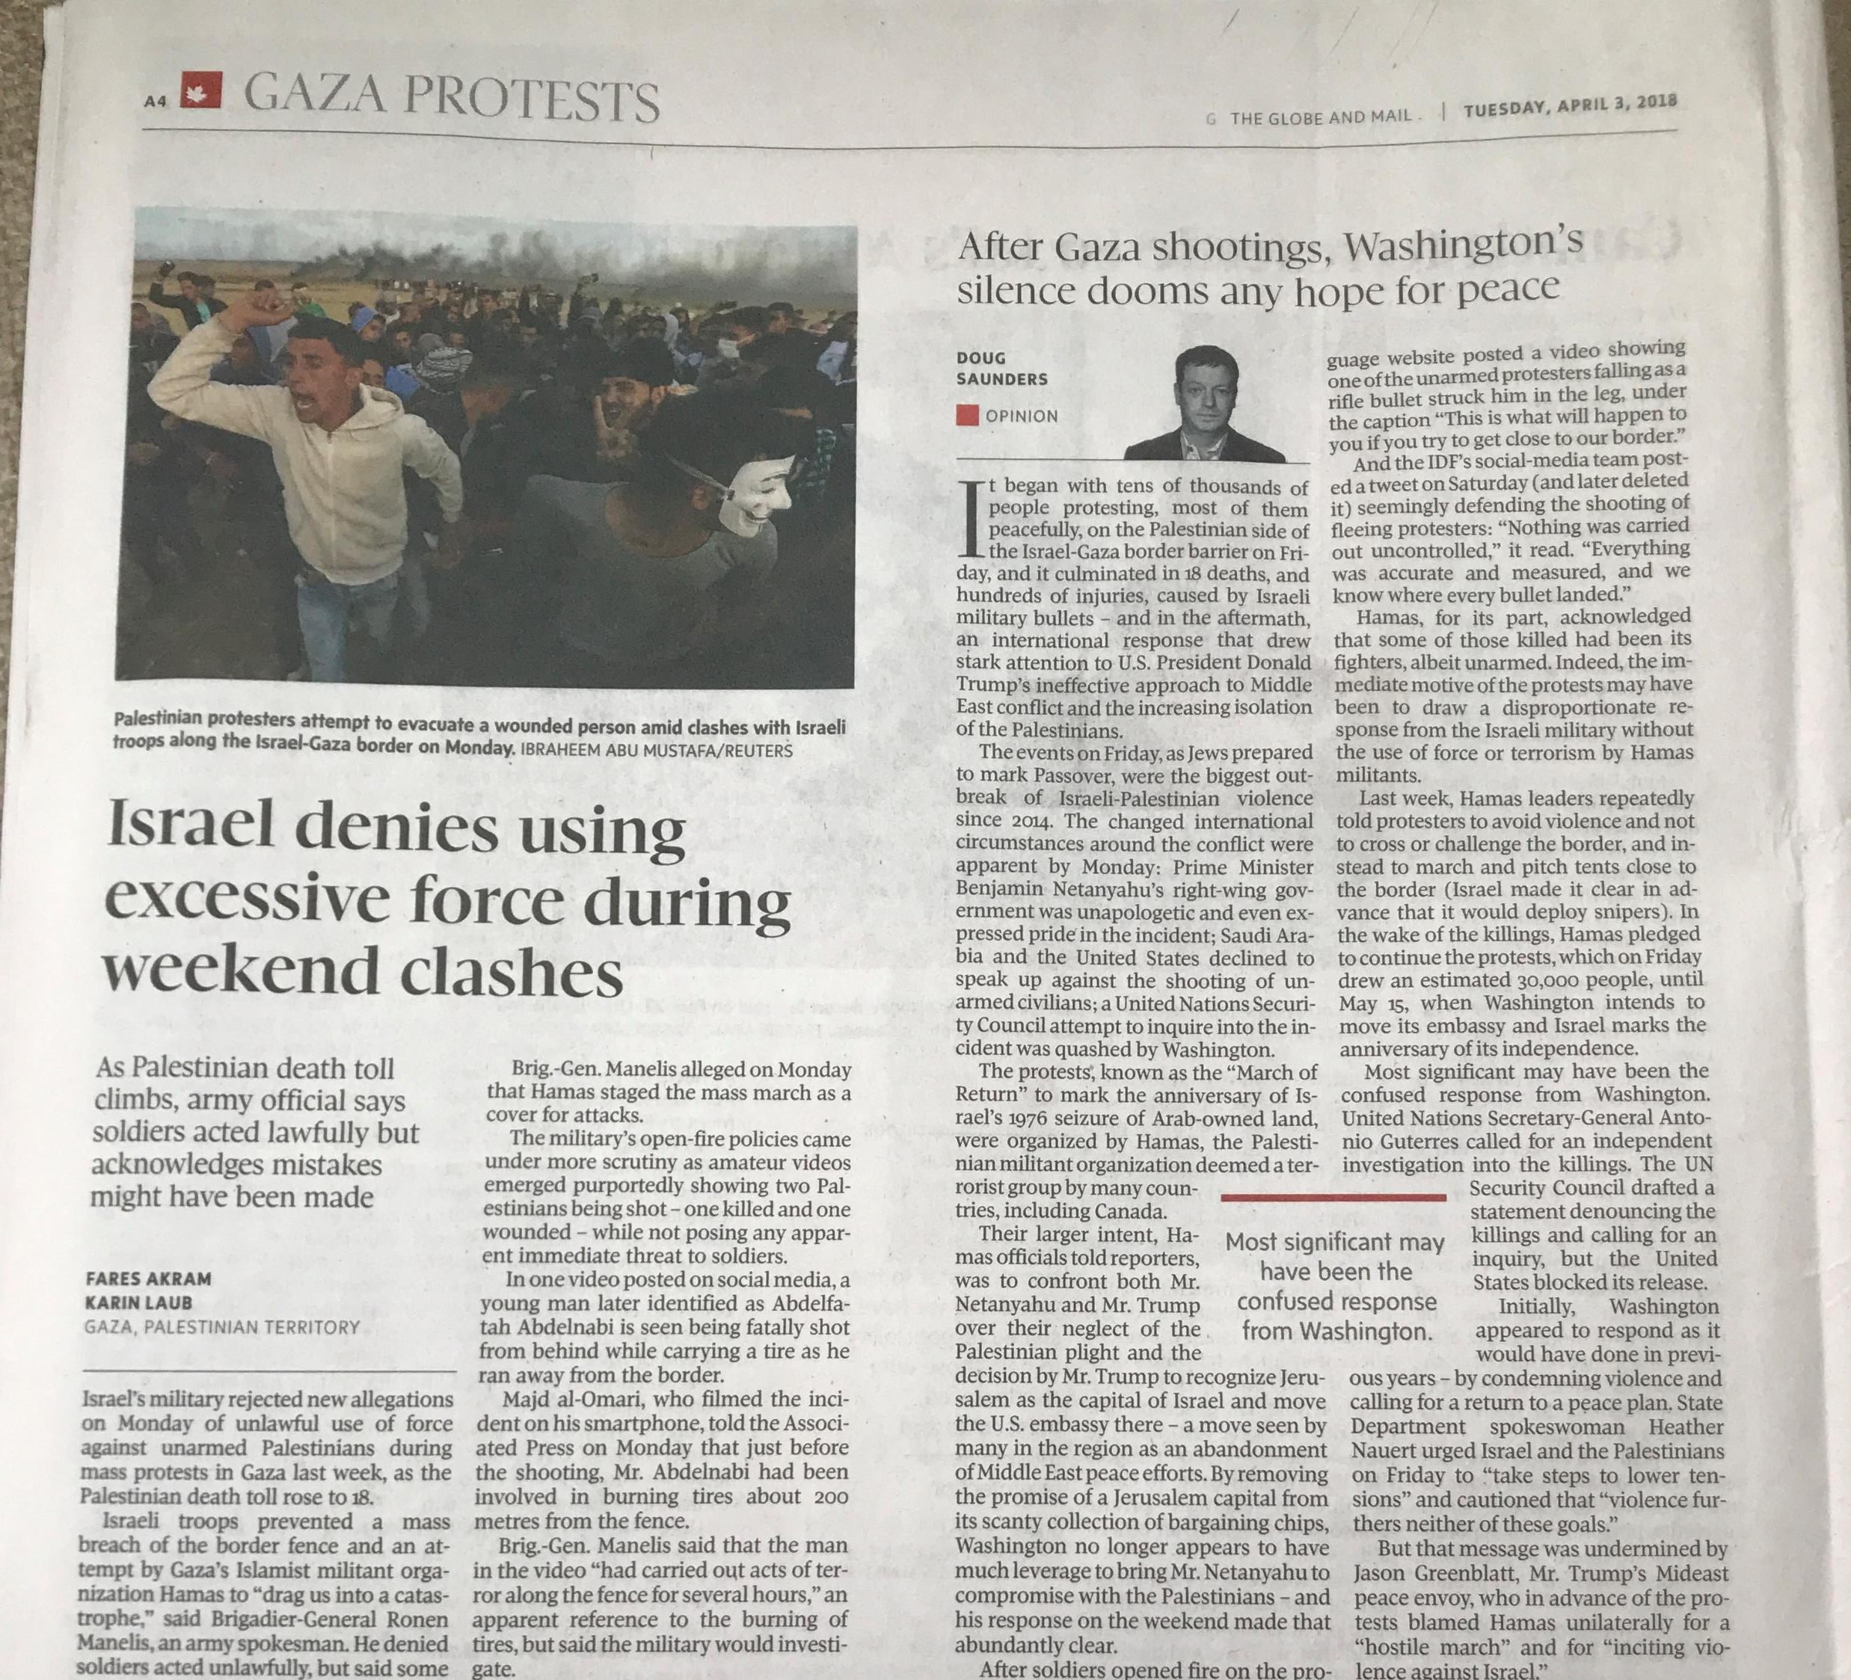
Situation Analysis
Data:
30,000 Gazan march on or near the Israeli border
18 Palestinians killed by IDF
Worst violence since 2014
Information:
Hamas organized /participated
Stones, tires, Molotov cocktails
Some protesters were shot in back
Intelligence:
March of “Return”
Not PA – West Bank (Unity)
U.S. Cover – Saudi recognition

Slide 6
War & Peace
In The Middle East
This is not an official CERTIFICATE
This is a THANK YOU note for your interest, patience and now a better understanding of the Middle East
Amnon Zohar
azohar.amnon@gmail.com

