Slide 1
War & Peace
In The Middle East
Lecture #7

Slide 2
Last week today
Mega Trends affecting Middle East
Regional Development Opportunities
Case Study – Israel
Discussion Q&A

Slide 3
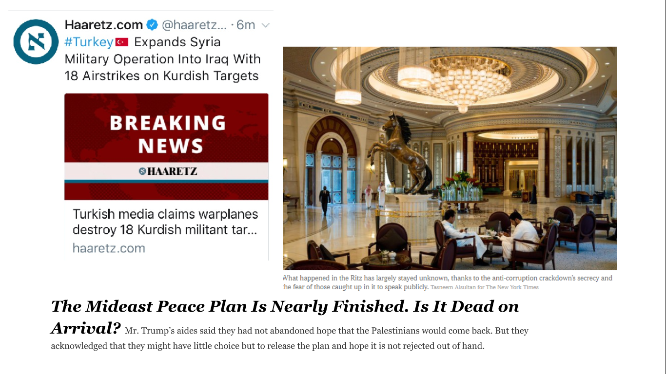
Gaza Conference – Sunni Block – Palestinians out
PA Prime Minister assassination attempt in Gaza

Slide 9
Why and how has Israel become a hot-bed for technological innovation and a power house in technology applications
Start-up Nation

Slide 10
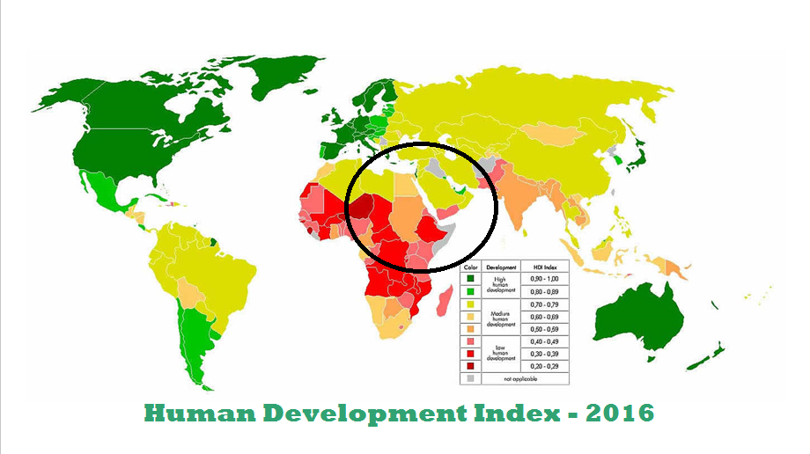

Slide 11
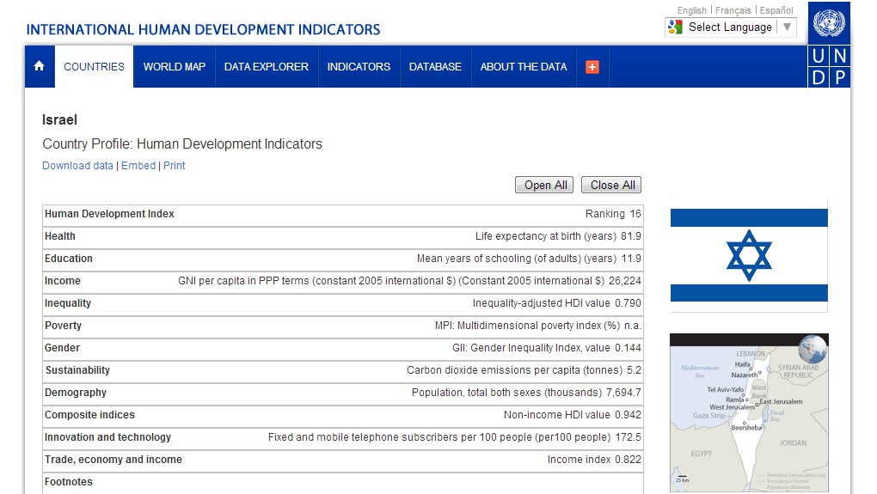
81.9
11.9
$26.2
172.5

Slide 12
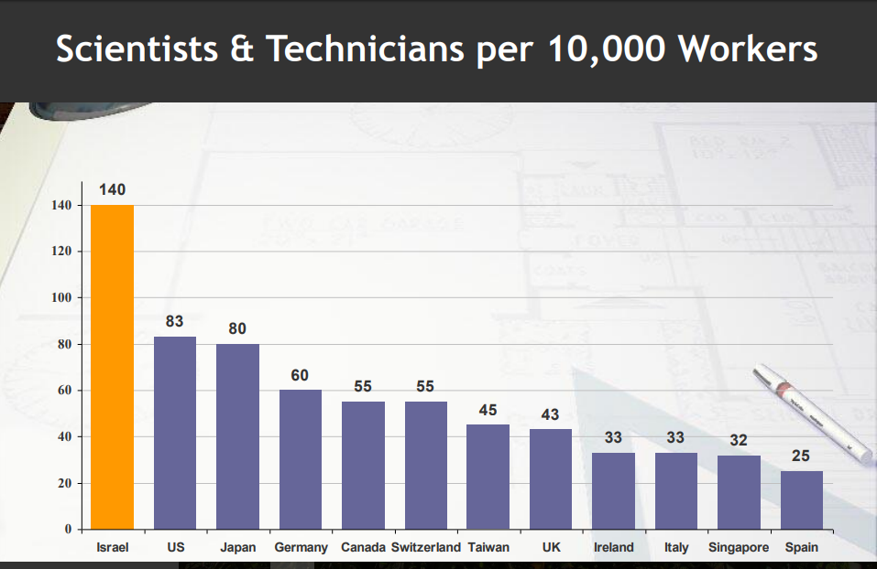
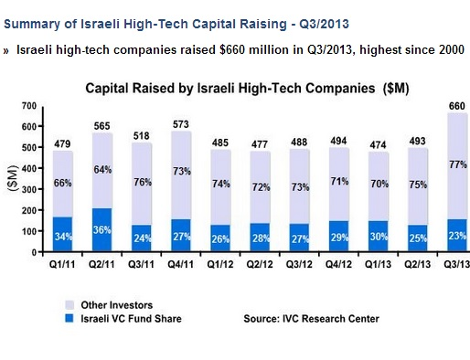

Slide 13
Global co-operation & Collaboration

Slide 14
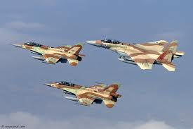
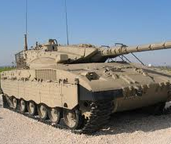
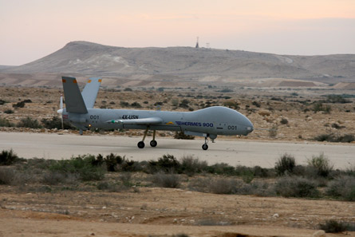
Military Superiority – Self-Sufficiency

Slide 15
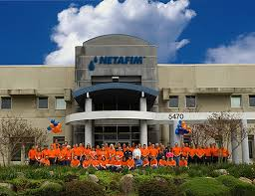
Lack of Natural Resources

Slide 16
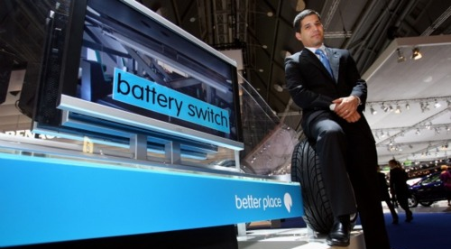
Technology & Innovation
“Israelis understand not only the financial and environmental costs of being dependent on oil but also the security costs of pumping money into the coffers of less-that-savory regimes”. Mr. Aggasi Founder of Better Place

Slide 17
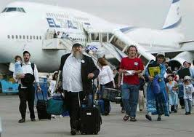
Immigration - Absorption

Slide 18
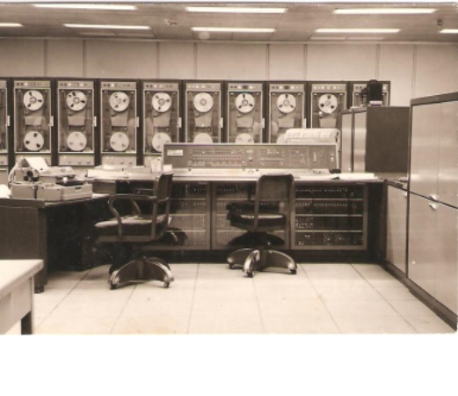
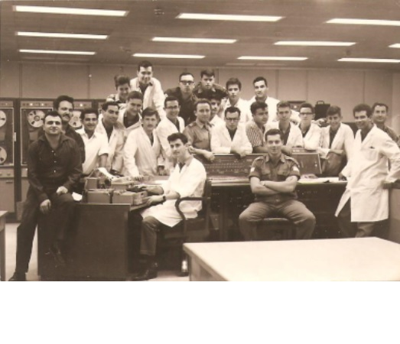
8:16 – 10:20
PHILCO 2000
1962

Slide 19
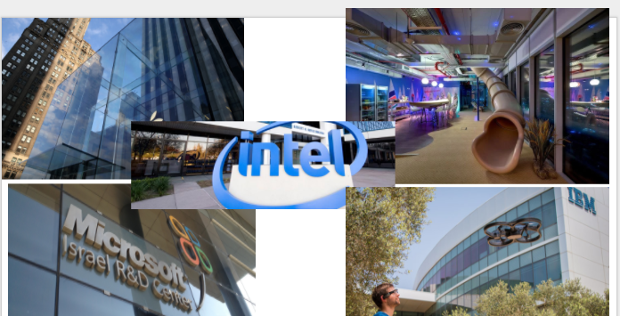

Slide 20
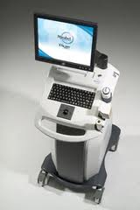

Slide 22
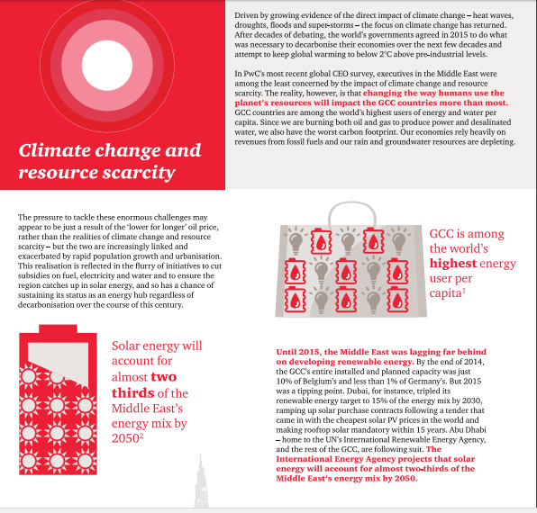
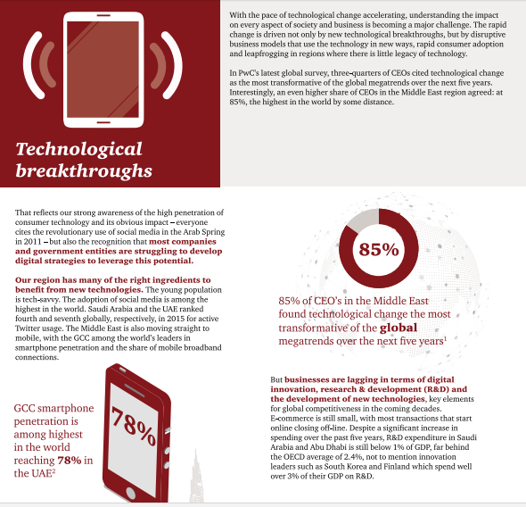
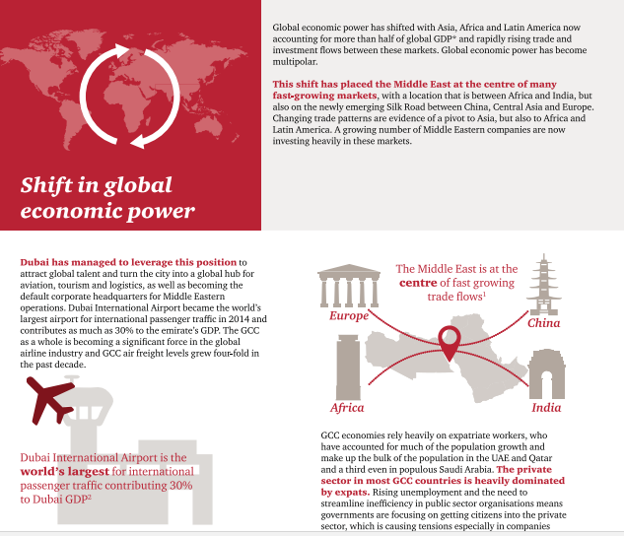

Slide 23
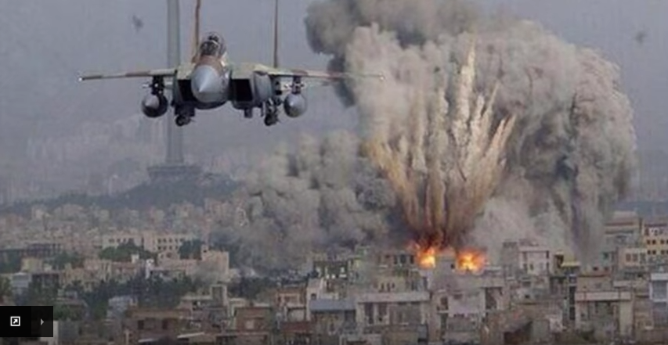
Could there be Peace?

Slide 25
The Middle East is not Funny – But can we not laugh from time to time?

Slide 26
War & Peace in The Middle East
Next Week:
Let’s Debate Some Key Issues
Thank You

Slide 27
https://www.slideshare.net/secret/MXBdJOyla0VDf4
https://www.indexmundi.com/map/?t=0&v=2229&r=me&l=en Slide 4
https://www.youtube.com/watch?v=2oZ2fxhg-VY Slide 7
https://www.youtube.com/watch?v=beGNG9X4TBI&t=1s Slide 6
https://www.youtube.com/watch?v=3UPiKqpSu5g Slide 8
https://www.youtube.com/watch?v=deOmrZINIcM Slide 9
https://www.youtube.com/watch?v=W6EJp0u54eI&t=5s Slide 14
https://www.youtube.com/watch?v=Rr0ReW8U2Ns&t=13s Slide 15
https://www.youtube.com/watch?feature=player_embedded&v=takha-lVb-w&t=441 Slide 16
https://www.youtube.com/watch?v=rYE9UgmVrfU&t=521s Slide18
https://www.youtube.com/watch?v=0g-eyo6v5UE&t=3s Slide 20
https://www.youtube.com/watch?v=QCtUc-BwyYs&t=114s Slide 23
https://www.youtube.com/watch?v=lE4jWBjsbBk&t=8s Slide 25

